Slide 1
Norfolk District, U.S. Army Corps of Engineers
Presentation to Governor McAuliffe
July 8th, 2015
Paul B. Olsen, P.E.
Colonel, U.S. Army
Commanding

Slide 2
Three Levels of Effort
  Tactical - Deliver the Program ($680 Million)
    Construction Program (Military, Civil Works, Other Gov’t Agencies
    Regulatory Program
  Operational - Port Modernization
    55’ + Southern Branch Deepening
    Craney Island Eastern Expansion (CIEE)
    Post Panamex Dredging
  Strategic - Sea Level Rise and Climate Change (SLR/CC)
    North Atlantic Coast Comprehensive Study (NACCS)
    Whole of Government approach to SLR/CC
    Projects/Studies (Norfolk Comprehensive)
Notes:
COL Backus brief 2nd bullet – Who is the Corps.
CAPT and COL to jointly brief common shared interests.

Slide 3
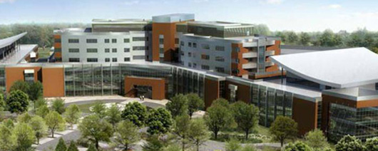
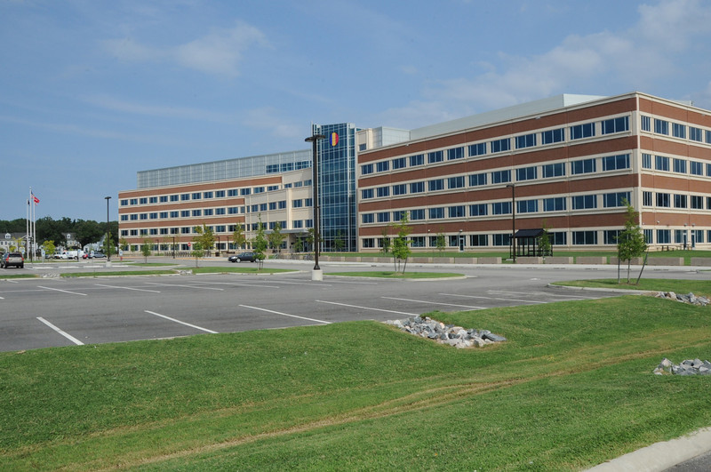
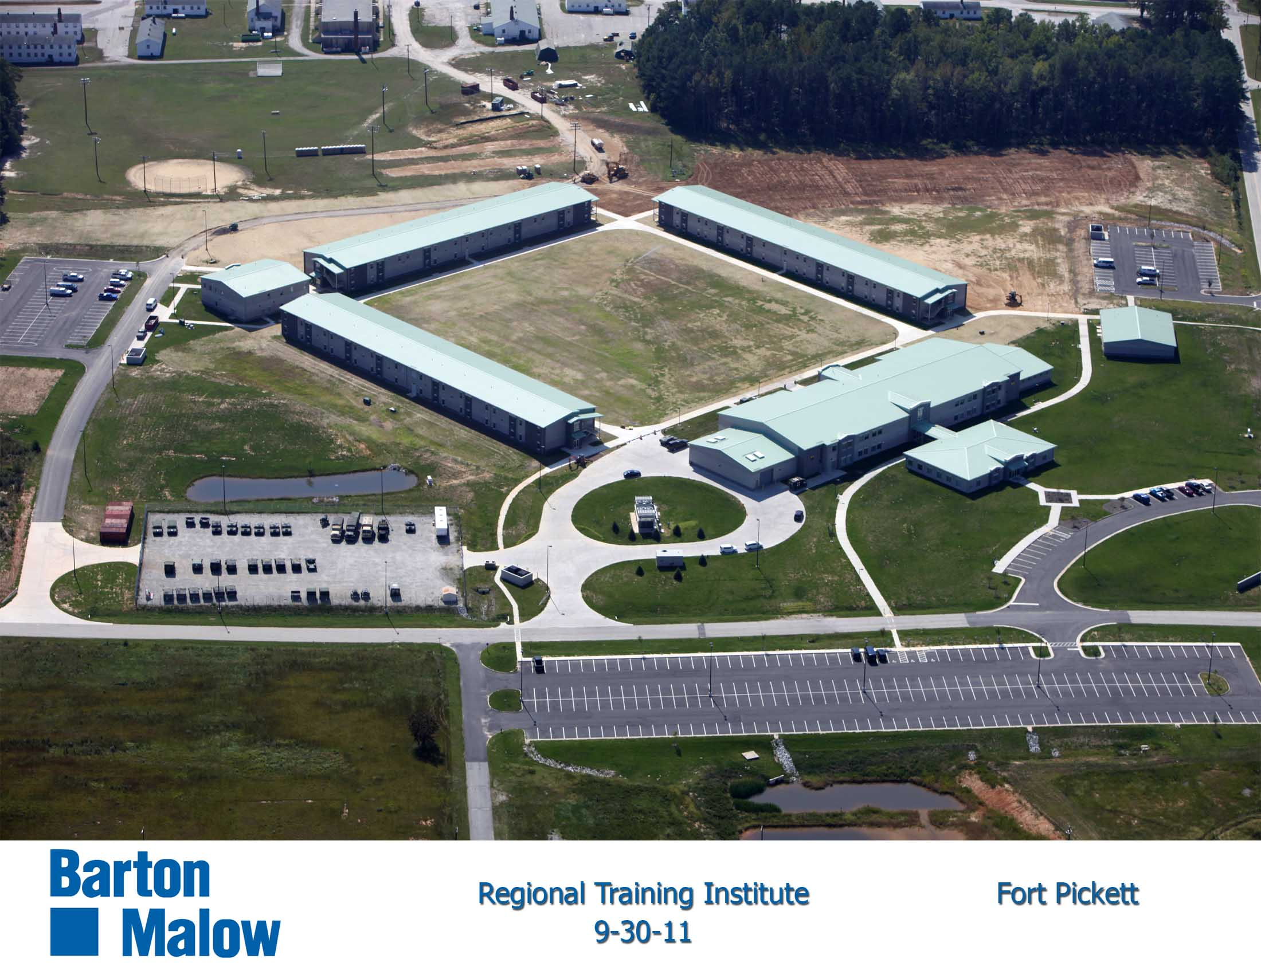
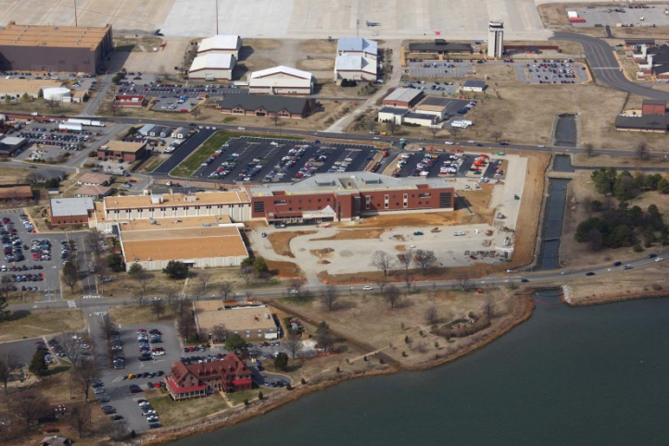
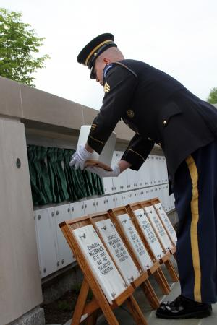
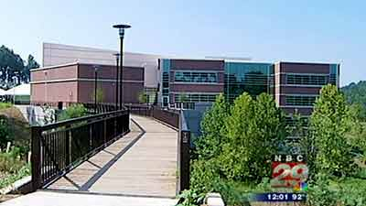
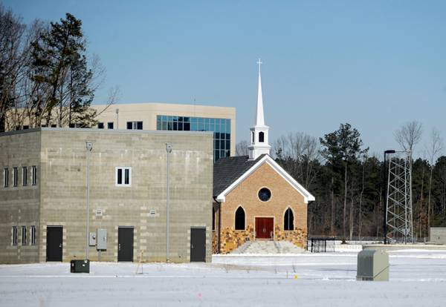
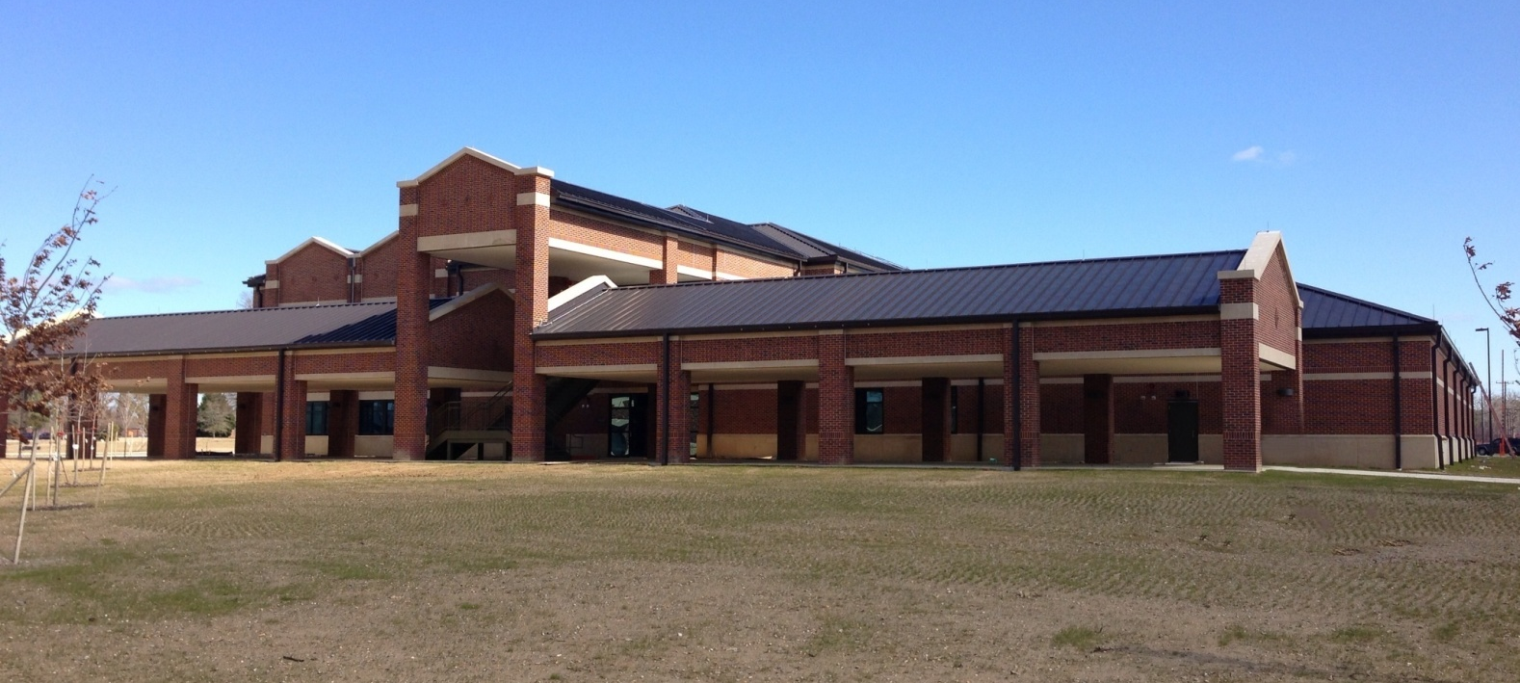
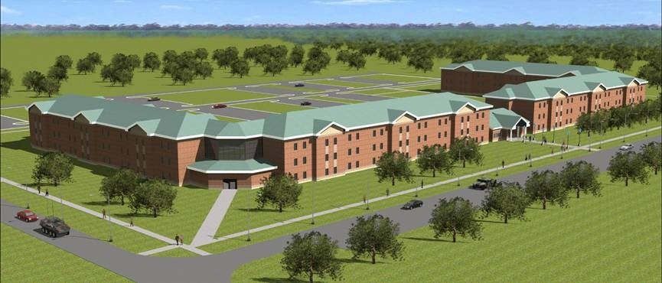
Tactical: Deliver the Program
“You May Have Heard of…”
Fort Belvoir Community Hospital
Fort Picket Training Brigade
TRADOC Headquarters
Langley Hospital Addition
Rivanna’s Joint Use Intel Facility
Asymmetric Warfare
Group Training Complex
Fort A.P. Hill
ANC’s Columbarium 9
Our Award Winning DFACs
New and Modernized Barracks at Forts Eustis and Lee
Notes:
3
Slide 35: Fort Belvoir Community Hospital

Slide 4
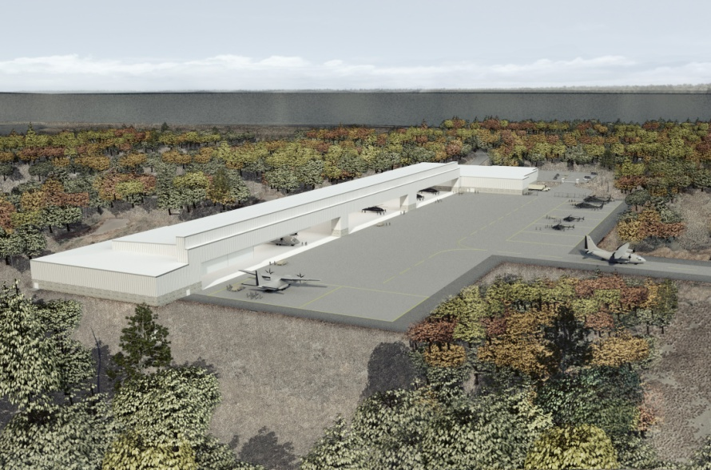
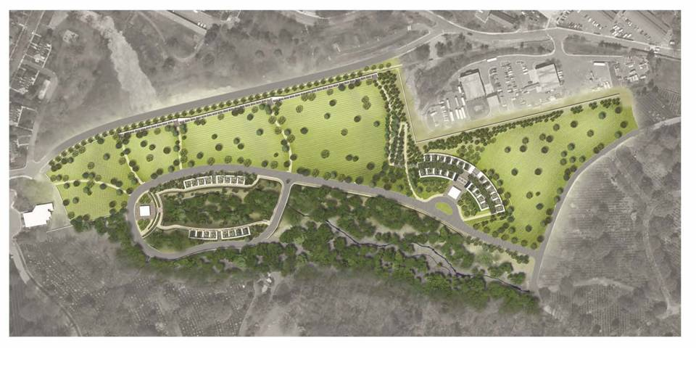
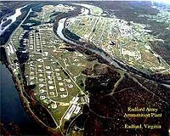
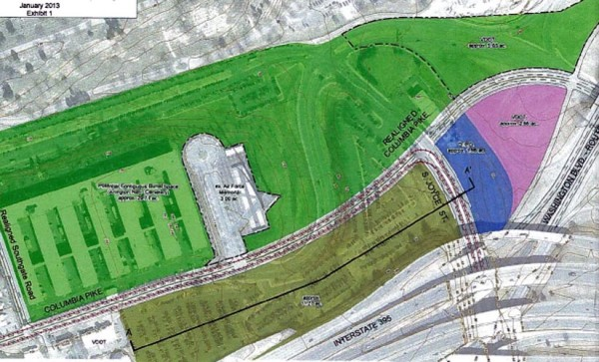

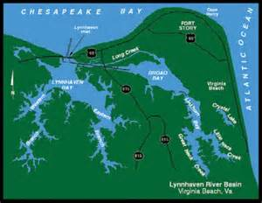
“You will soon see…”
Flight Concepts Division Hanger
at Fort Eustis
Millennium Expansion at Arlington National Cem
Clean Power Plant for
Radford AAP
Southern Expansion at
Arlington National Cemetery
$34M Lynnhaven Tributary
Restoration
$40M - $120M worth of facilities
For NASA Langley Research Center

Slide 5
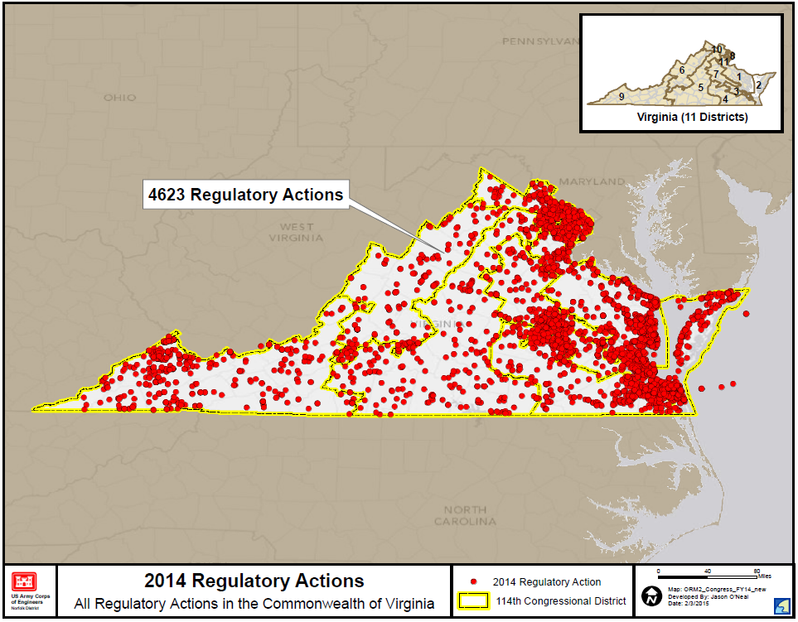
Tactical: Deliver the Program
Our Regulatory Program averages about 4000-5000 actions per year!

Slide 6
Operational: Port Modernization
The top priority for the District is to get the Federal Channel to 55’
The Harbor hosts the largest Navy Base in the World as well as being the Port of Choice for the Post Panamex Vessels. This is a sample of the complexity of the District’s efforts for a 55’ channel.
Notes:
CAPT Ogle to brief first bullet – USCG and USACE Staff Talks. The reason for the briefing.
COL Backus brief 2nd bullet – Who is the Corps.
CAPT and COL to jointly brief common shared interests.

Slide 7
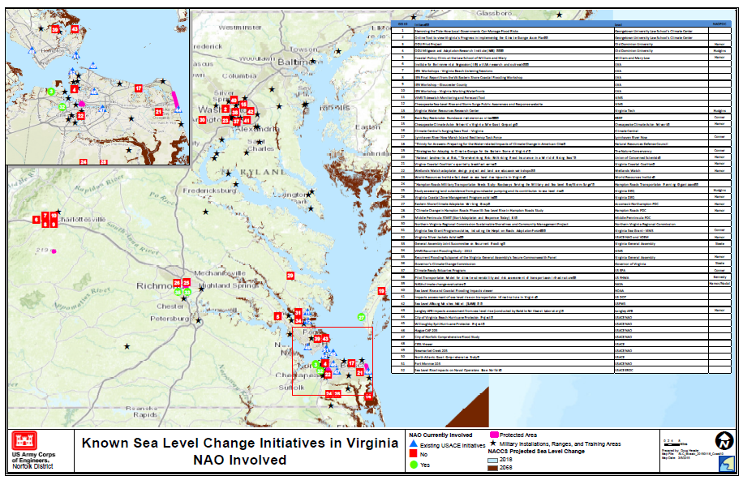
Strategic: Sea Level Rise (SLR)
Sea Level Rise and Climate Change are important because Hampton Roads has twice the relative sea level rise of any other East Coast Location
This demonstrates the complexity of the problem and the number of efforts ongoing to counter this clear and present challenge
Notes:
CAPT Ogle to brief first bullet – USCG and USACE Staff Talks. The reason for the briefing.
COL Backus brief 2nd bullet – Who is the Corps.
CAPT and COL to jointly brief common shared interests.

Slide 8
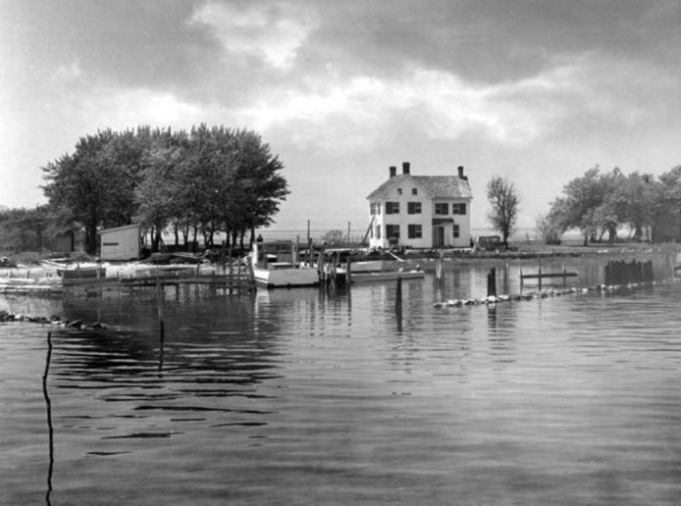
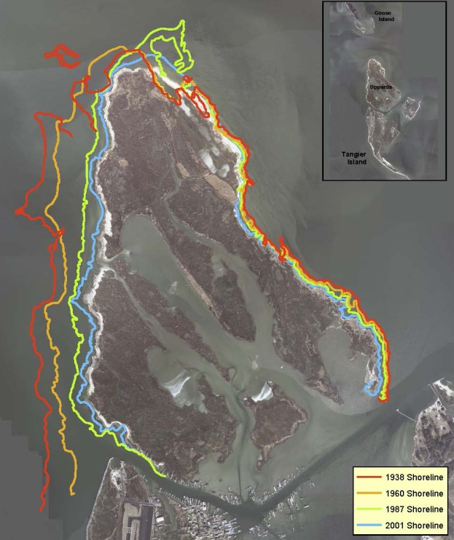
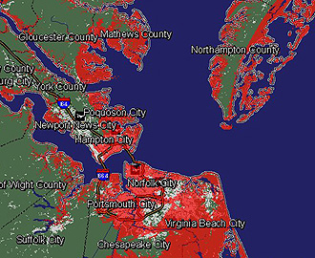
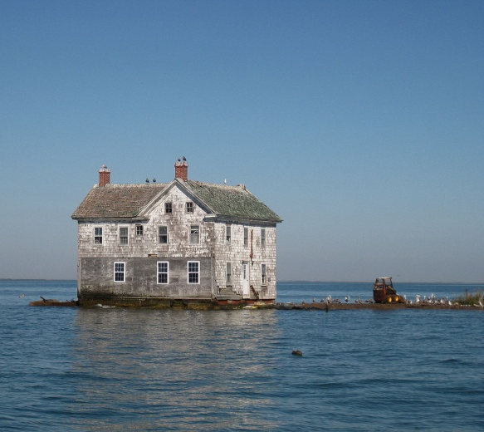
Holland Island, Tangier Island, Hampton Roads
Holland Island
Tangier Island
Hampton Roads
This last house shown collapsed in 2010

Slide 9
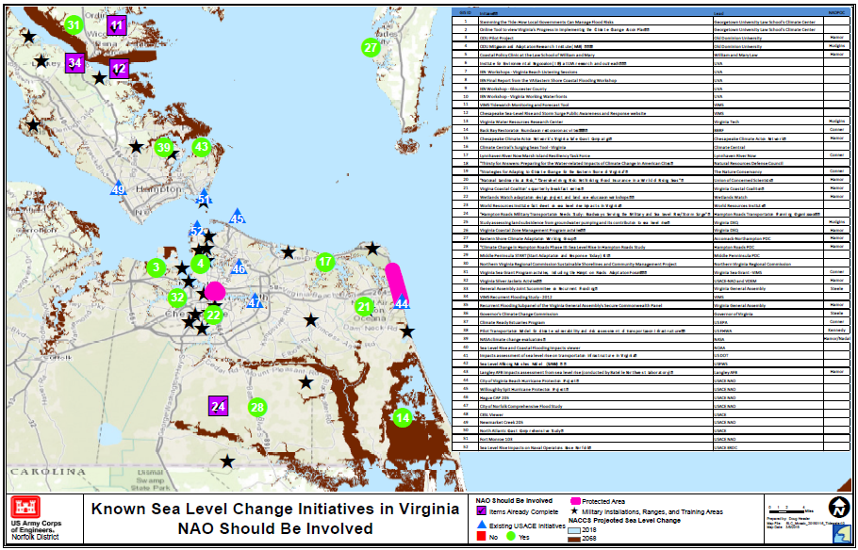
Strategic: Sea Level Rise (SLR)
A detailed view illustrates where the efforts are bringing solutions and where studies need to be done using the NACCS as a framework
Notes:
CAPT Ogle to brief first bullet – USCG and USACE Staff Talks. The reason for the briefing.
COL Backus brief 2nd bullet – Who is the Corps.
CAPT and COL to jointly brief common shared interests.

Slide 10
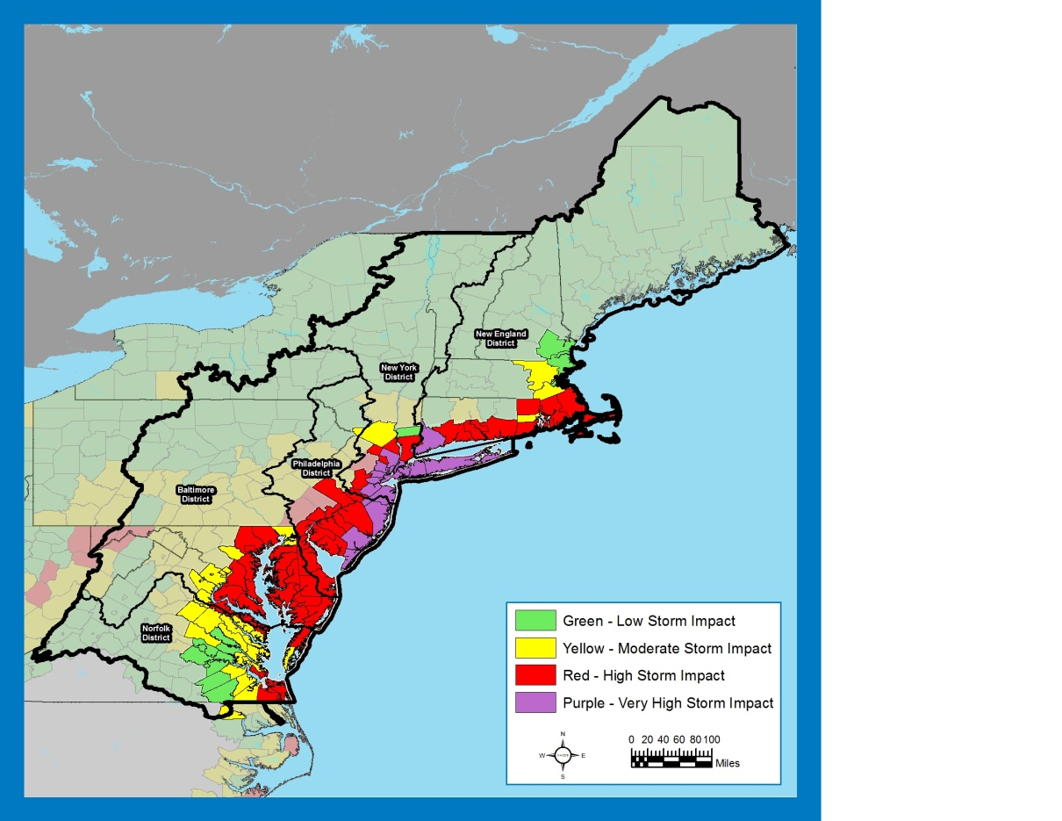
North Atlantic Coastal Comprehensive Study (NACCS)
“That using up to $20,000,000* of the funds provided herein, the Secretary shall conduct a comprehensive study to address the flood risks of vulnerable coastal populations in areas that were affected by Hurricane Sandy within the boundaries of the North Atlantic Division of the Corps ….” (*19M after sequestration)
  Goals
  Provides a Risk Management Framework – not a plan
  Supports Resilient Coastal Communities and robust, sustainable coastal landscape systems
  Considers future sea level rise scenarios, to reduce risk to vulnerable population, property, ecosystems, and infrastructure
  Whole of Government Approach
www.nad.usace.army.mil/CompStudy

Slide 11
NACCS Describes a
Full Spectrum of Projects

Slide 12
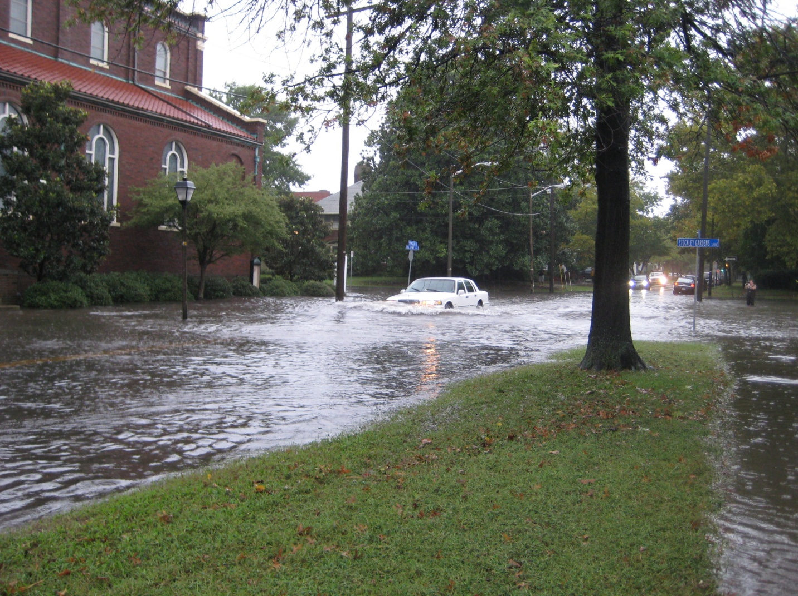
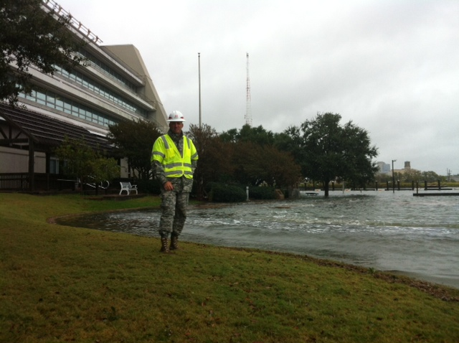
The NACCS Identified Norfolk
NACCS Identified nine focus areas
Three studies were funded for FY16 – one being Norfolk
Norfolk is ready to cost share the study
Notes:
Previous Events
June 3, 2014: Pilot Project kickoff at the TechSurge conference
June 30, 2014: “Rising to the Challenge,” bipartisan forum for Virginia members of Congress organized by Senator Kaine Big Blue Room
July 1, 2014: Governor’s Climate Commission announced
Aug, 2014: Pilot website rollout – www.centerforsealevelrise.org
Oct 10, 2014; Pilot Charter signed
Oct 28, 2014: Sen Kaine letter
Dec 2, 2014: FEMA NEP Tabletop to galvanize the pilot and help transition to Whole of Community
Jan 15, 2015: Commission approves HRPDC participation

Slide 13
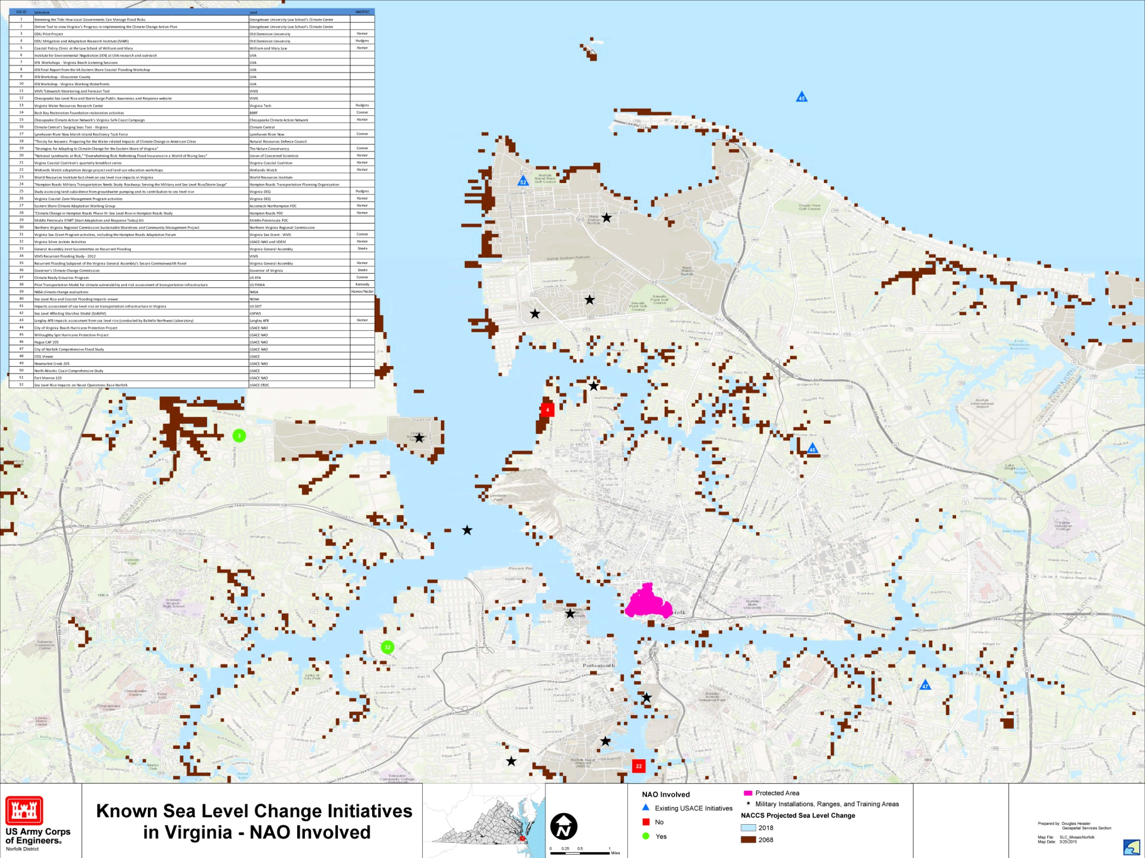
The Norfolk Study will Authorize “Projects”
Notes:
Previous Events
June 3, 2014: Pilot Project kickoff at the TechSurge conference
June 30, 2014: “Rising to the Challenge,” bipartisan forum for Virginia members of Congress organized by Senator Kaine Big Blue Room
July 1, 2014: Governor’s Climate Commission announced
Aug, 2014: Pilot website rollout – www.centerforsealevelrise.org
Oct 10, 2014; Pilot Charter signed
Oct 28, 2014: Sen Kaine letter
Dec 2, 2014: FEMA NEP Tabletop to galvanize the pilot and help transition to Whole of Community
Jan 15, 2015: Commission approves HRPDC participation

Slide 14
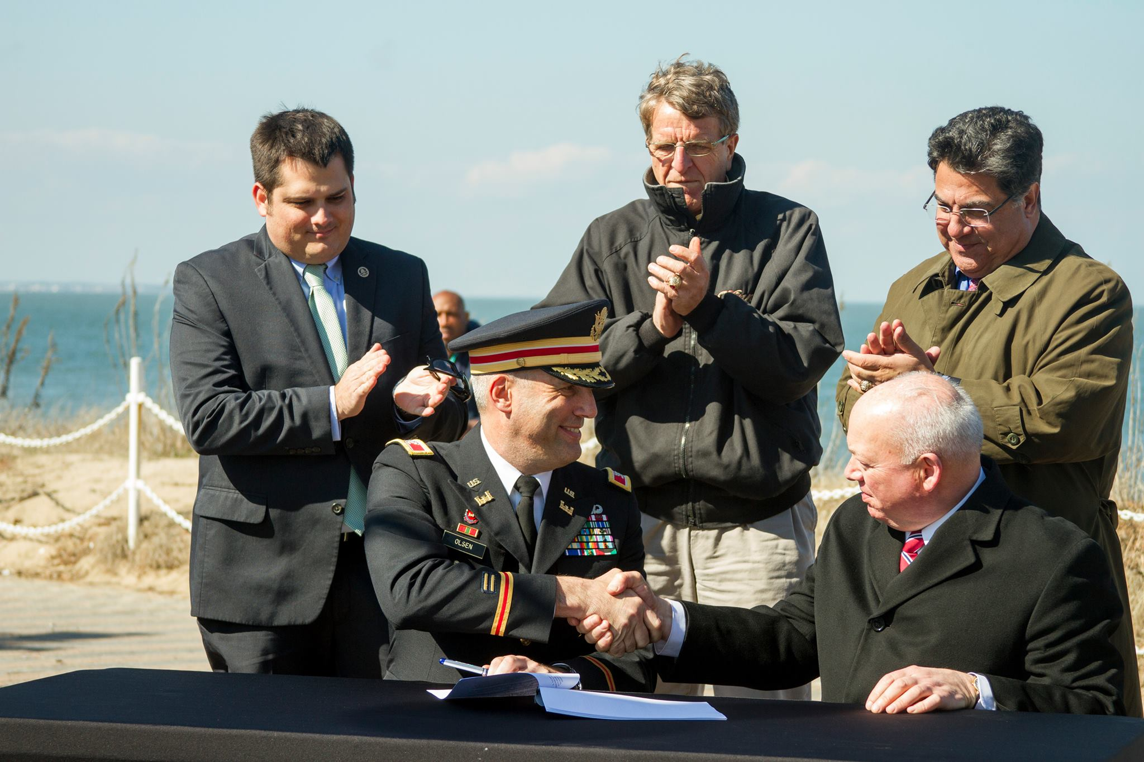
Authorized Projects Await Congressional Appropriations and Non Federal Cost Share
Notes:
Previous Events
June 3, 2014: Pilot Project kickoff at the TechSurge conference
June 30, 2014: “Rising to the Challenge,” bipartisan forum for Virginia members of Congress organized by Senator Kaine Big Blue Room
July 1, 2014: Governor’s Climate Commission announced
Aug, 2014: Pilot website rollout – www.centerforsealevelrise.org
Oct 10, 2014; Pilot Charter signed
Oct 28, 2014: Sen Kaine letter
Dec 2, 2014: FEMA NEP Tabletop to galvanize the pilot and help transition to Whole of Community
Jan 15, 2015: Commission approves HRPDC participation

Slide 15
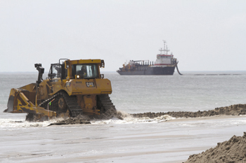
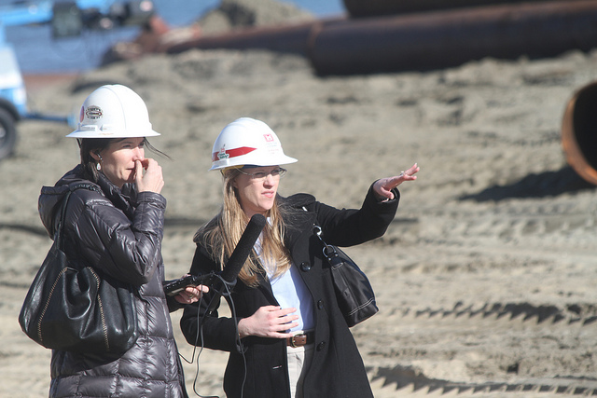
Funded Projects are Constructed
Sandbridge Project
Virginia Beach
Notes:
Previous Events
June 3, 2014: Pilot Project kickoff at the TechSurge conference
June 30, 2014: “Rising to the Challenge,” bipartisan forum for Virginia members of Congress organized by Senator Kaine Big Blue Room
July 1, 2014: Governor’s Climate Commission announced
Aug, 2014: Pilot website rollout – www.centerforsealevelrise.org
Oct 10, 2014; Pilot Charter signed
Oct 28, 2014: Sen Kaine letter
Dec 2, 2014: FEMA NEP Tabletop to galvanize the pilot and help transition to Whole of Community
Jan 15, 2015: Commission approves HRPDC participation

Slide 16
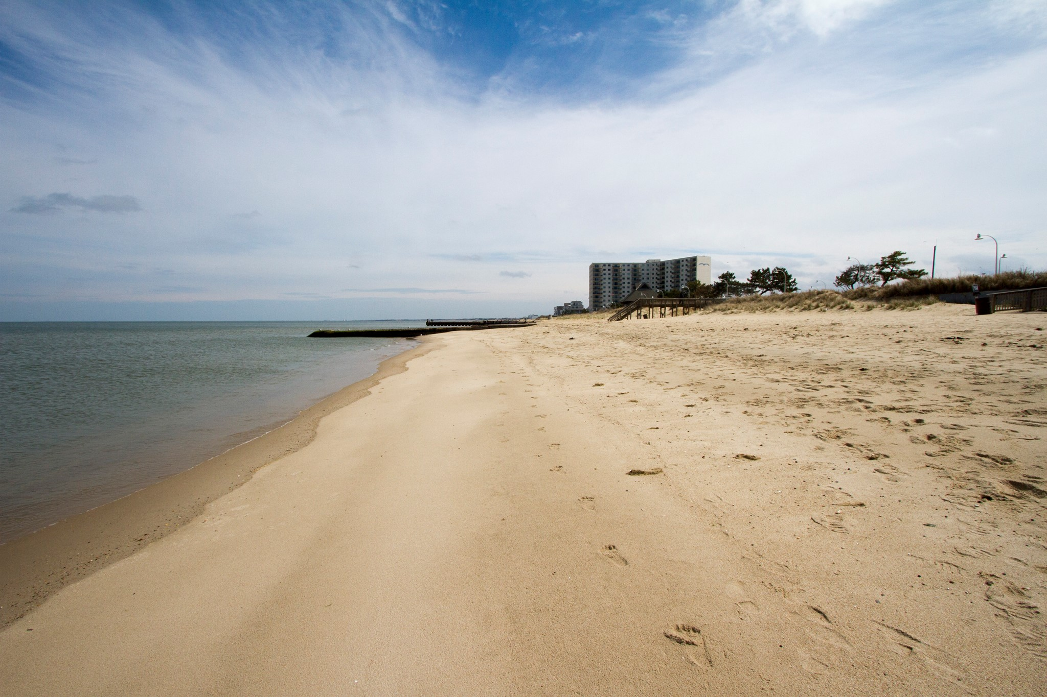
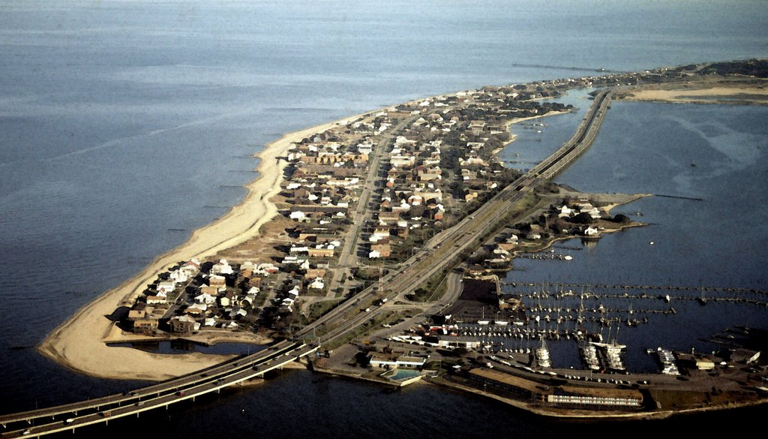
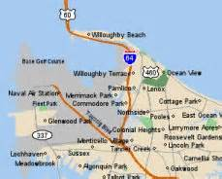
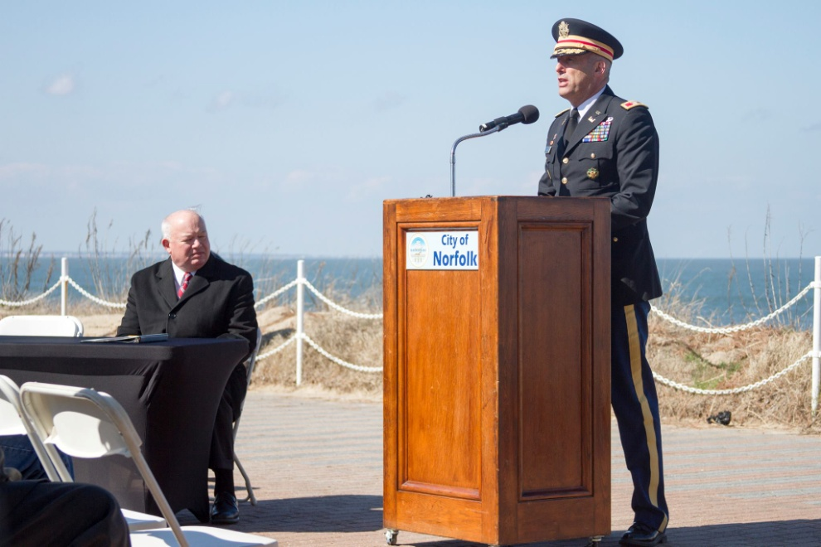
“The sea level rise fight starts right here, right now.”
April 10, 2015
Willoughby
Spit
Notes:
CAPT Ogle to brief first bullet – USCG and USACE Staff Talks. The reason for the briefing.
COL Backus brief 2nd bullet – Who is the Corps.
CAPT and COL to jointly brief common shared interests.

Slide 17
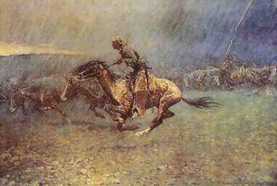
Our Future?
A Requirement for Leadership

Slide 18
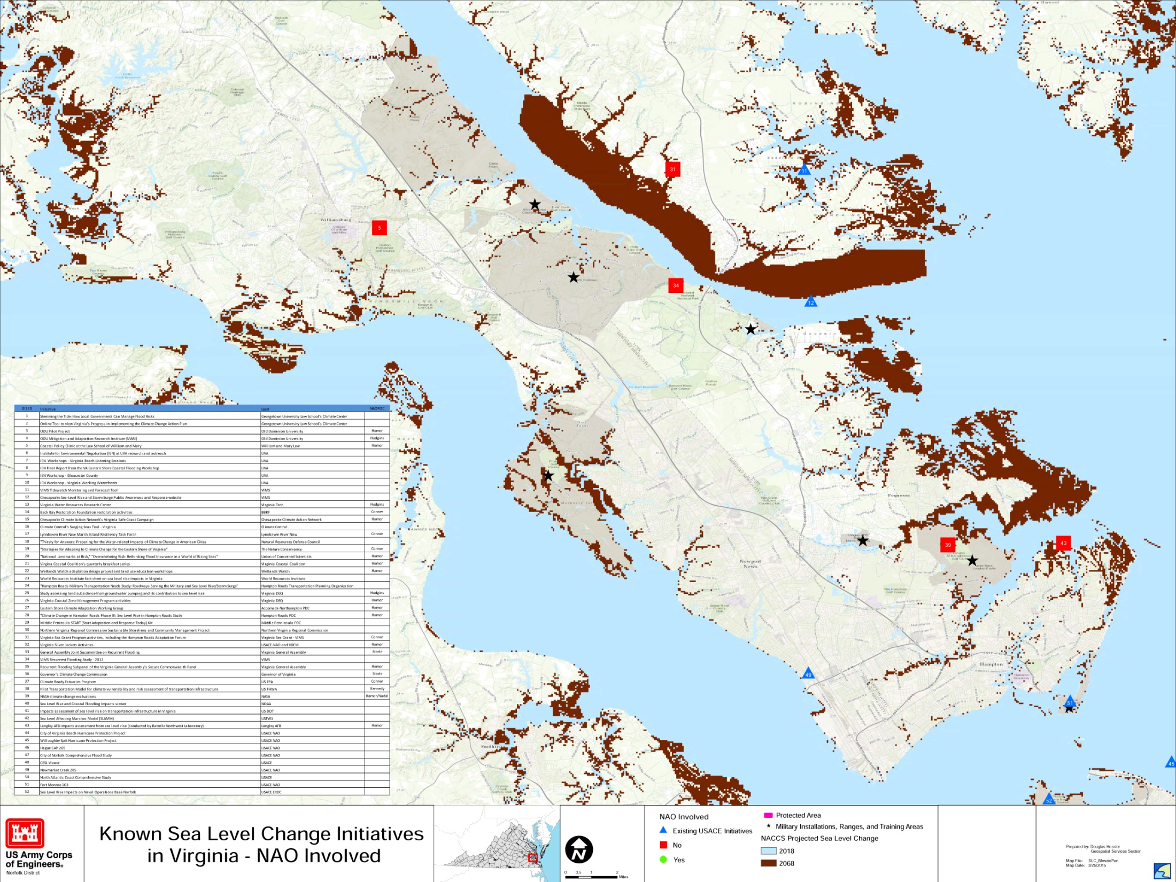
Our Future?
A Geophysical Approach

Slide 19
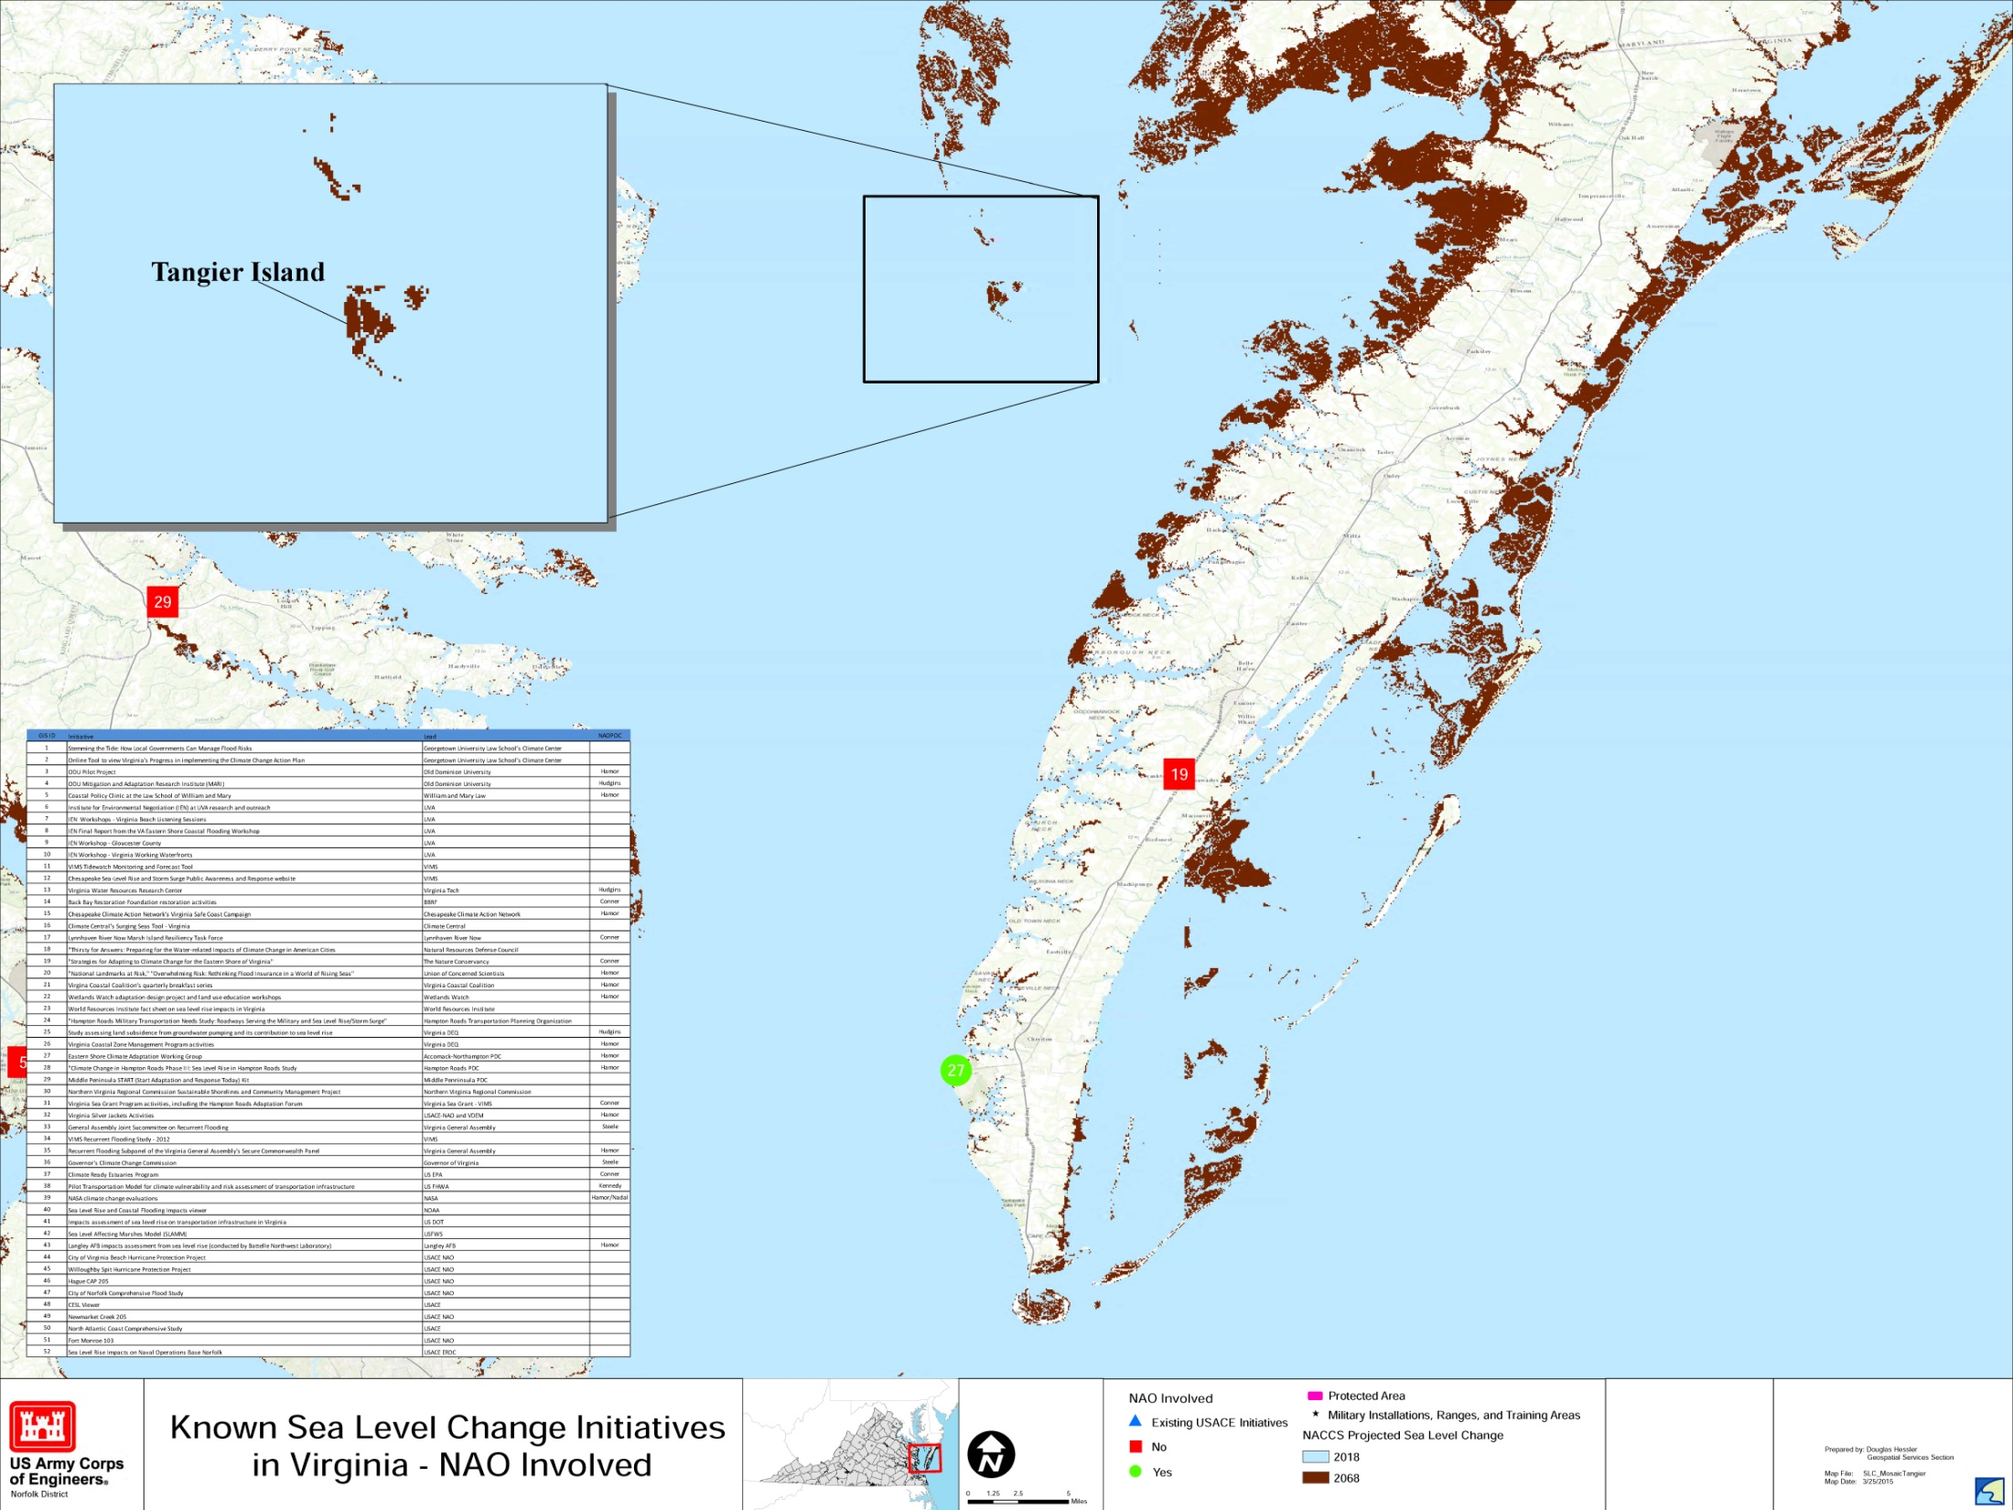
Our Future?
Identify Geophysical Regions
Prioritize Regions
Budget for Study Cost Share ($1.5M ea)
Budget for Projects (Studies and Construction)
Metrics and Milestones
A Strategic Campaign Plan

Slide 20
Our Future?
A Spirit of Partnership

Slide 21
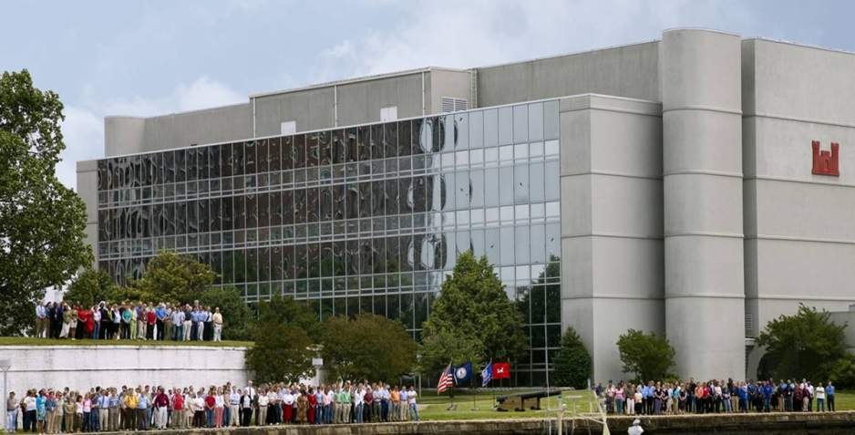
We Are Norfolk District
380 Dedicated Federal Employees
At Your Service – Ready for your Questions

