Slide 1
Norfolk District, U.S. Army Corps of Engineers
Dutch Dialogues: Virginia – Life at Sea Level
Coastal Resilient Communities
June 19, 2015
Paul B. Olsen, P.E.
Colonel, U.S. Army
Commanding

Slide 2
For Context --Three Levels of Effort
  Tactical - Deliver the Program ($680 Million)
    Construction Program (Military, Civil Works, Other Gov’t Agencies
    Regulatory Program
  Operational - Port Modernization
    55’ + Southern Branch Deepening
    Craney Island Eastern Expansion (CIEE)
    Post Panamex Dredging
  Strategic - Sea Level Rise and Climate Change (SLR/CC)
    North Atlantic Coast Comprehensive Study (NACCS)
    Whole of Government approach to SLR/CC
    Projects/Studies (Norfolk Comprehensive)
Notes:
COL Backus brief 2nd bullet – Who is the Corps.
CAPT and COL to jointly brief common shared interests.

Slide 3
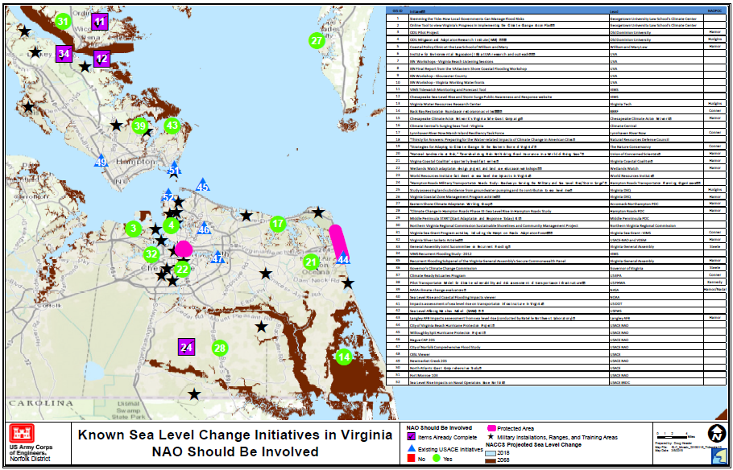
Strategic: Sea Level Rise (SLR)
A detailed view illustrates where the efforts are bringing solutions and where studies need to be done using the NACCS as a framework
Notes:
CAPT Ogle to brief first bullet – USCG and USACE Staff Talks. The reason for the briefing.
COL Backus brief 2nd bullet – Who is the Corps.
CAPT and COL to jointly brief common shared interests.

Slide 4
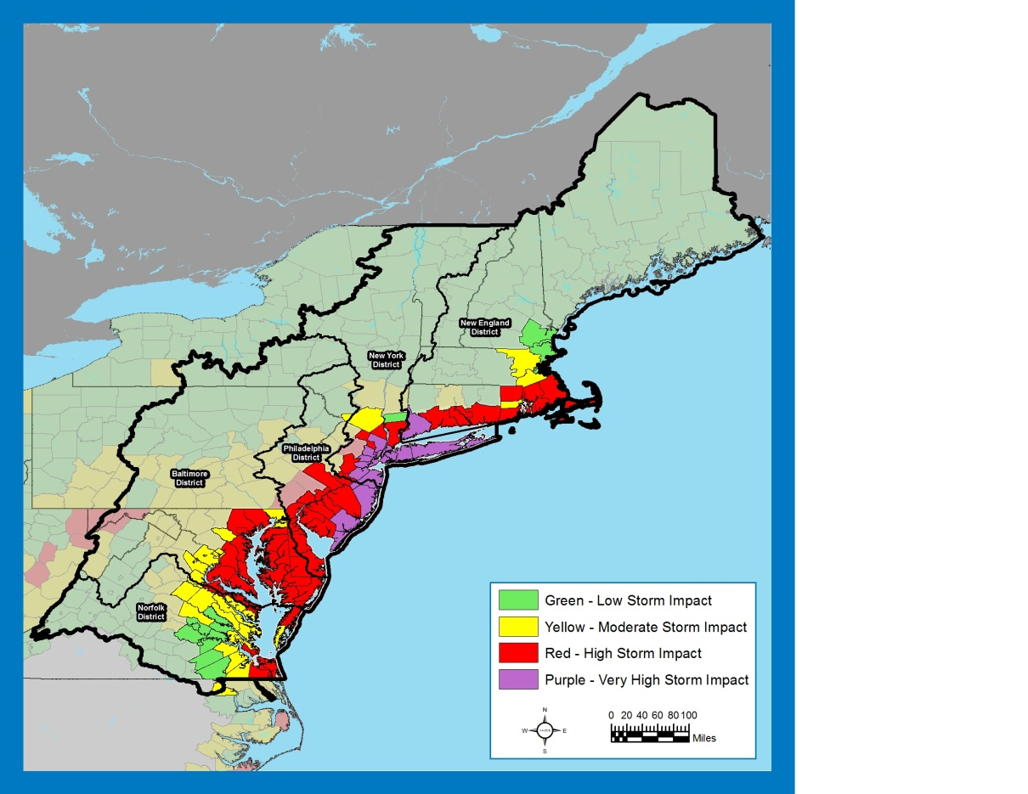
North Atlantic Coastal Comprehensive Study (NACCS)
“That using up to $20,000,000* of the funds provided herein, the Secretary shall conduct a comprehensive study to address the flood risks of vulnerable coastal populations in areas that were affected by Hurricane Sandy within the boundaries of the North Atlantic Division of the Corps ….” (*19M after sequestration)
  Goals
  Provides a Risk Management Framework – not a plan
  Supports Resilient Coastal Communities and robust, sustainable coastal landscape systems
  Considers future sea level rise scenarios, to reduce risk to vulnerable population, property, ecosystems, and infrastructure
  Whole of Government Approach
www.nad.usace.army.mil/CompStudy

Slide 5
NACCS Describes a
Full Spectrum of Projects

Slide 6
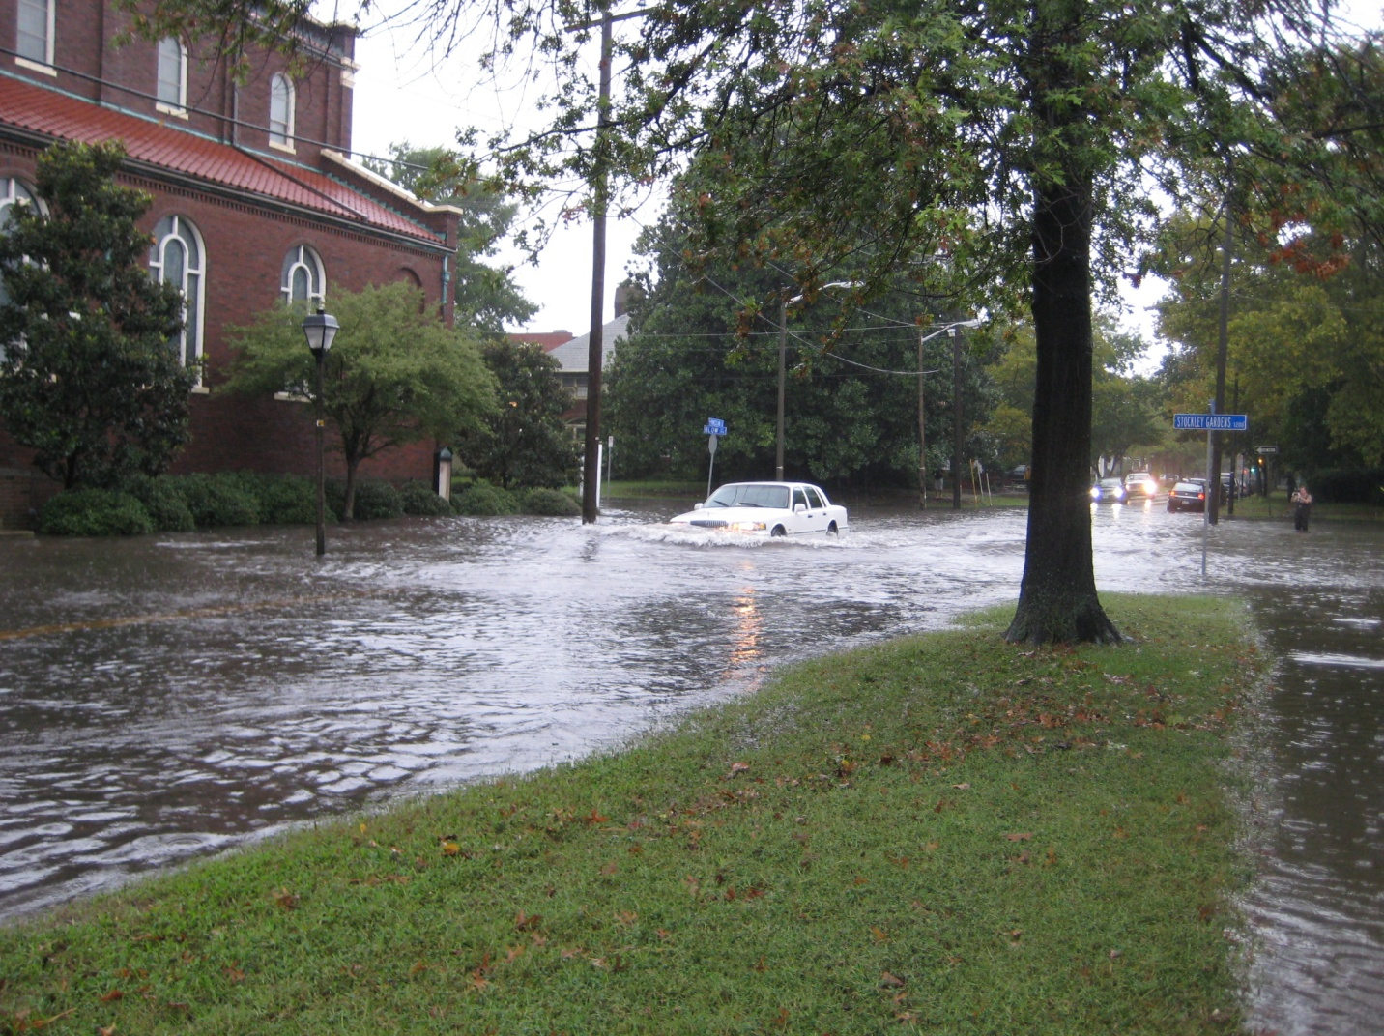
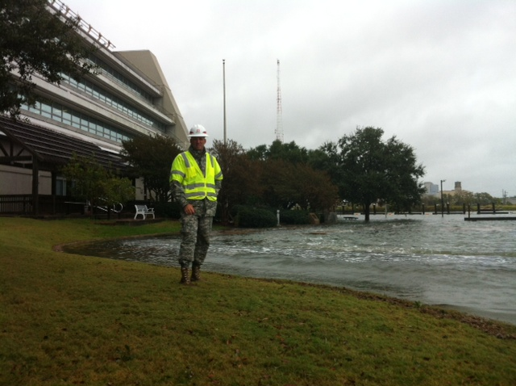
The NACCS Identified Norfolk
NACCS Identified nine focus areas
Three studies were funded for FY16 – one being Norfolk
Norfolk is ready to cost share the study
Notes:
Previous Events
June 3, 2014: Pilot Project kickoff at the TechSurge conference
June 30, 2014: “Rising to the Challenge,” bipartisan forum for Virginia members of Congress organized by Senator Kaine Big Blue Room
July 1, 2014: Governor’s Climate Commission announced
Aug, 2014: Pilot website rollout – www.centerforsealevelrise.org
Oct 10, 2014; Pilot Charter signed
Oct 28, 2014: Sen Kaine letter
Dec 2, 2014: FEMA NEP Tabletop to galvanize the pilot and help transition to Whole of Community
Jan 15, 2015: Commission approves HRPDC participation

Slide 7
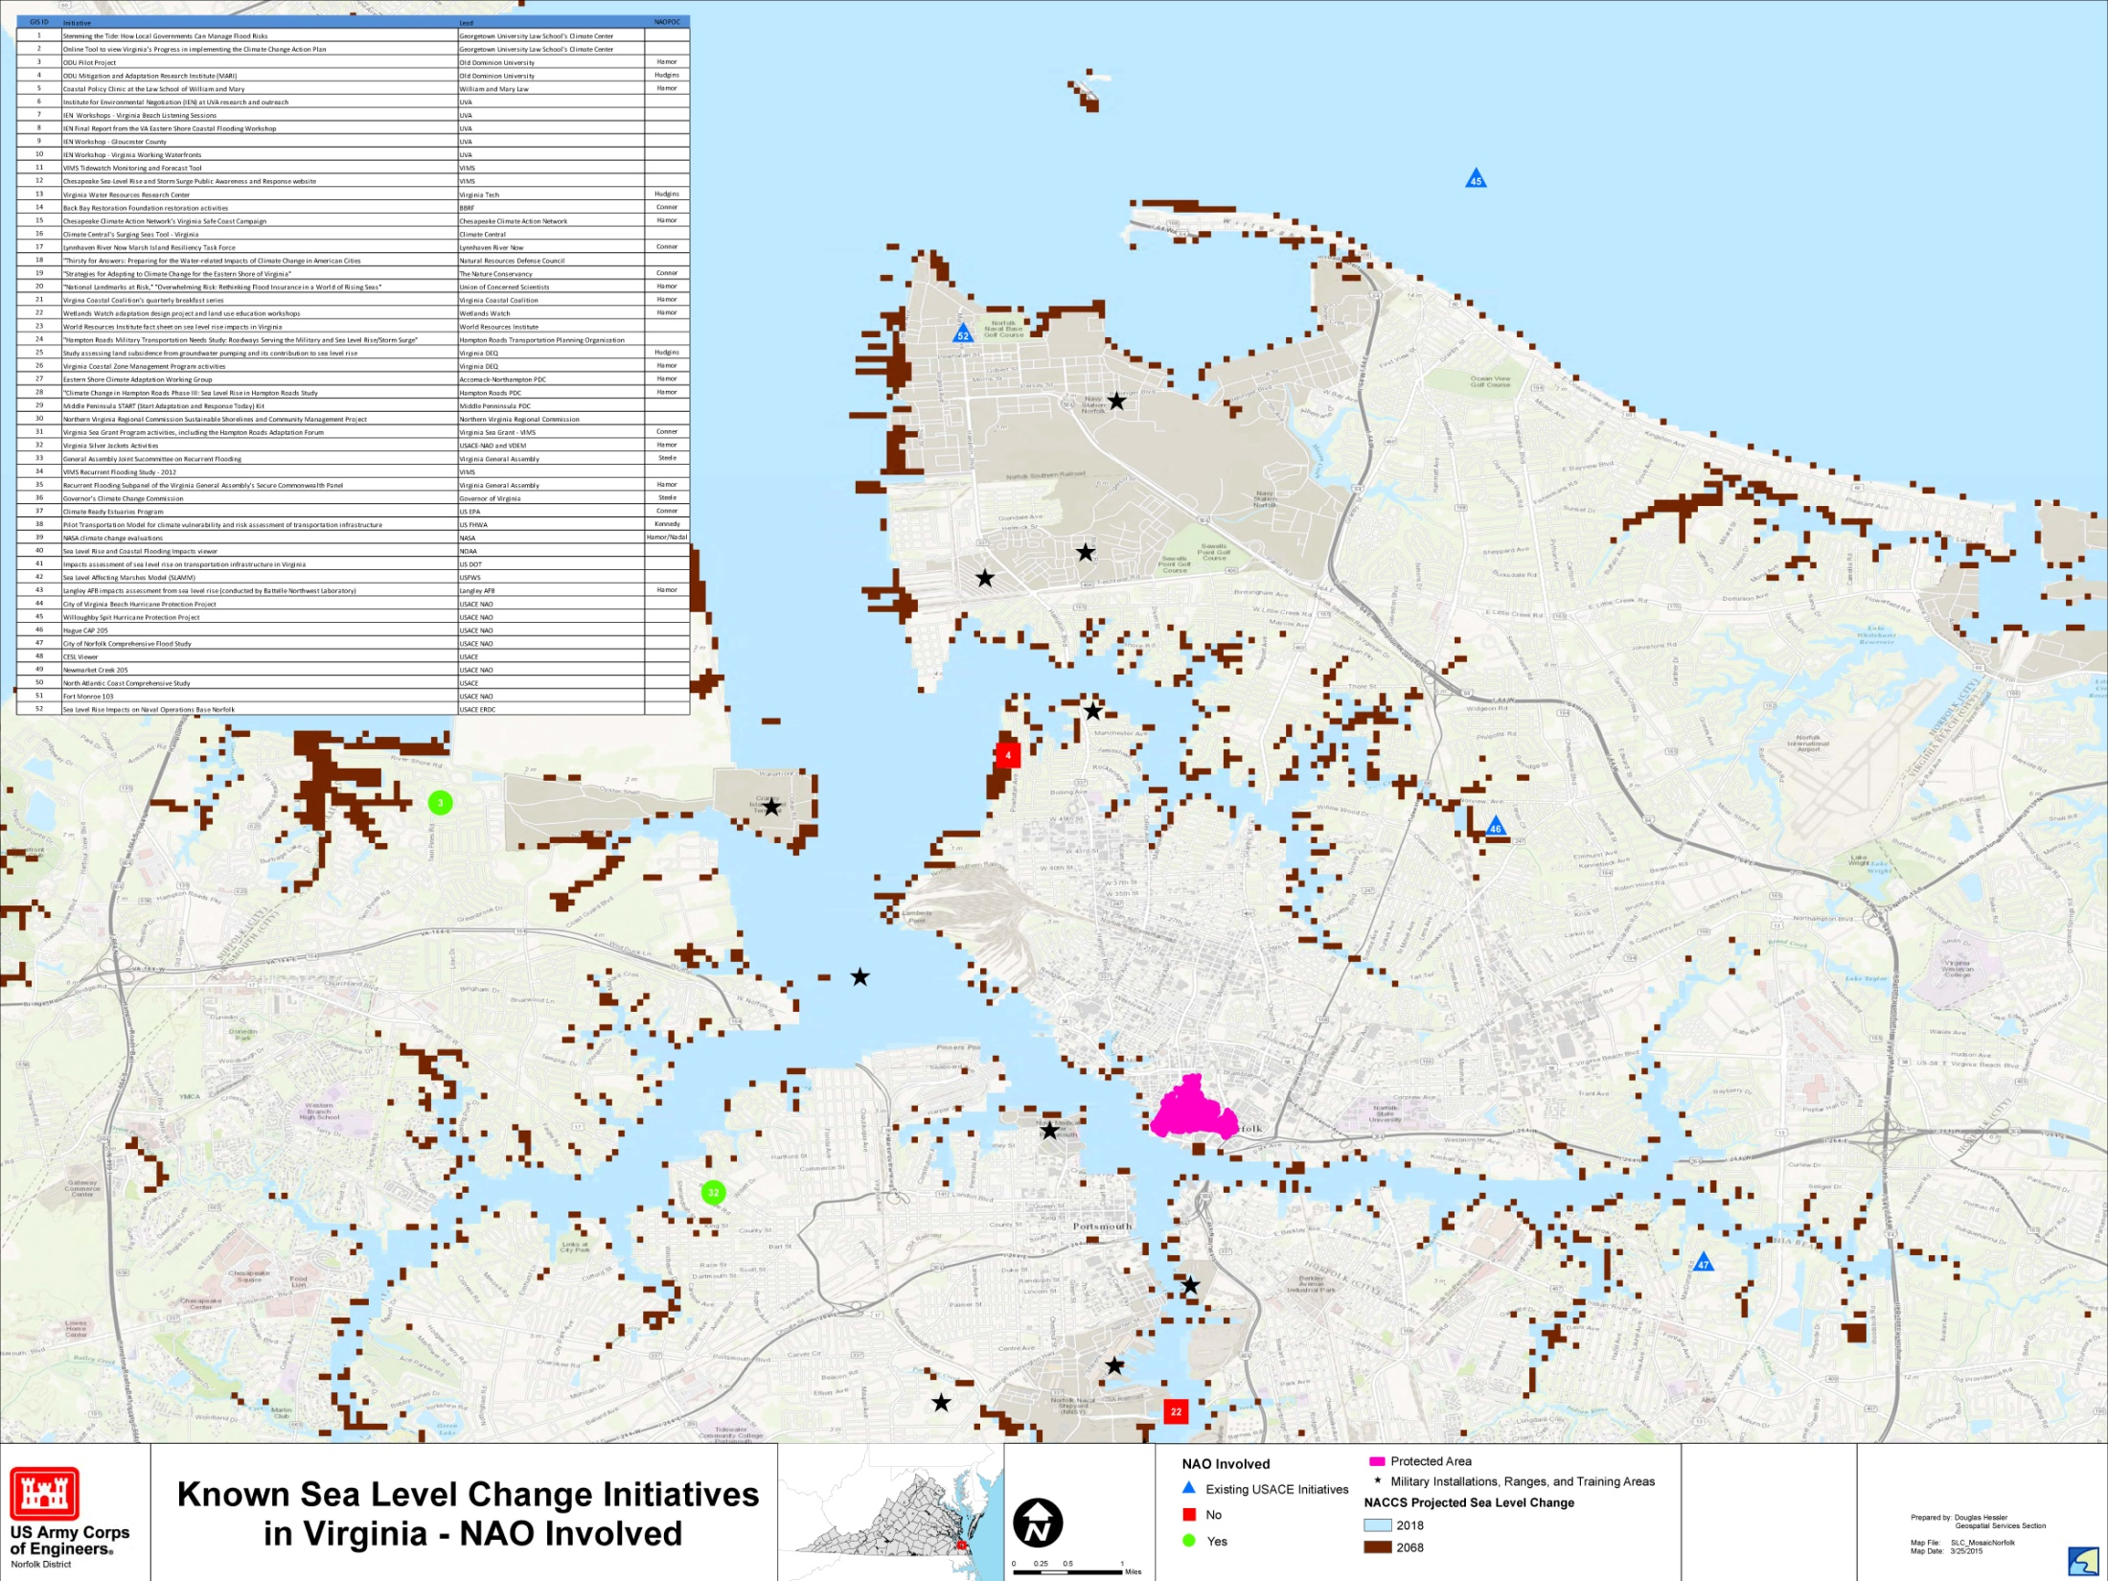
The Norfolk Study will Authorize “Projects”
Notes:
Previous Events
June 3, 2014: Pilot Project kickoff at the TechSurge conference
June 30, 2014: “Rising to the Challenge,” bipartisan forum for Virginia members of Congress organized by Senator Kaine Big Blue Room
July 1, 2014: Governor’s Climate Commission announced
Aug, 2014: Pilot website rollout – www.centerforsealevelrise.org
Oct 10, 2014; Pilot Charter signed
Oct 28, 2014: Sen Kaine letter
Dec 2, 2014: FEMA NEP Tabletop to galvanize the pilot and help transition to Whole of Community
Jan 15, 2015: Commission approves HRPDC participation

Slide 8
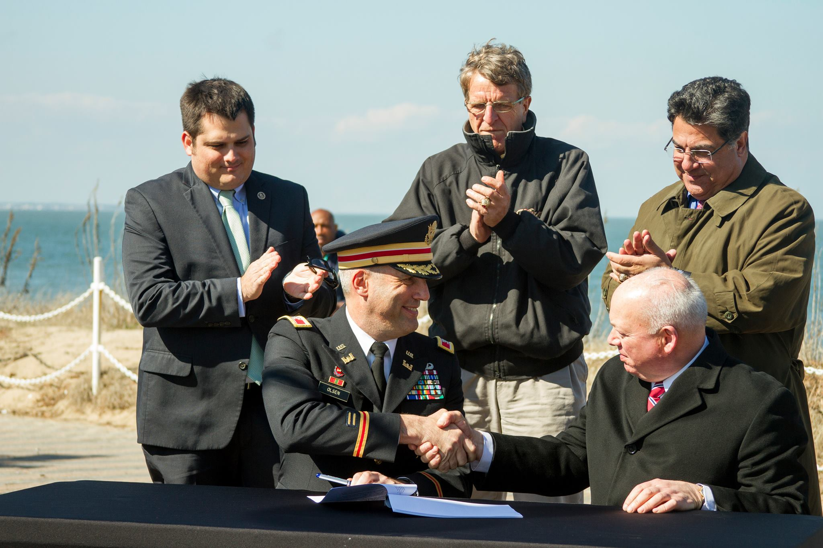
Authorized Projects Await Congressional Appropriations and Non Federal Cost Share
Notes:
Previous Events
June 3, 2014: Pilot Project kickoff at the TechSurge conference
June 30, 2014: “Rising to the Challenge,” bipartisan forum for Virginia members of Congress organized by Senator Kaine Big Blue Room
July 1, 2014: Governor’s Climate Commission announced
Aug, 2014: Pilot website rollout – www.centerforsealevelrise.org
Oct 10, 2014; Pilot Charter signed
Oct 28, 2014: Sen Kaine letter
Dec 2, 2014: FEMA NEP Tabletop to galvanize the pilot and help transition to Whole of Community
Jan 15, 2015: Commission approves HRPDC participation

Slide 9
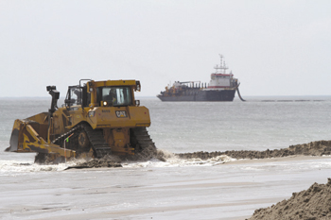
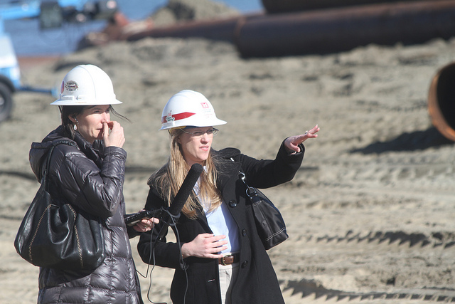
Funded Projects are Constructed
Sandbridge Project
Virginia Beach
Notes:
Previous Events
June 3, 2014: Pilot Project kickoff at the TechSurge conference
June 30, 2014: “Rising to the Challenge,” bipartisan forum for Virginia members of Congress organized by Senator Kaine Big Blue Room
July 1, 2014: Governor’s Climate Commission announced
Aug, 2014: Pilot website rollout – www.centerforsealevelrise.org
Oct 10, 2014; Pilot Charter signed
Oct 28, 2014: Sen Kaine letter
Dec 2, 2014: FEMA NEP Tabletop to galvanize the pilot and help transition to Whole of Community
Jan 15, 2015: Commission approves HRPDC participation

Slide 10
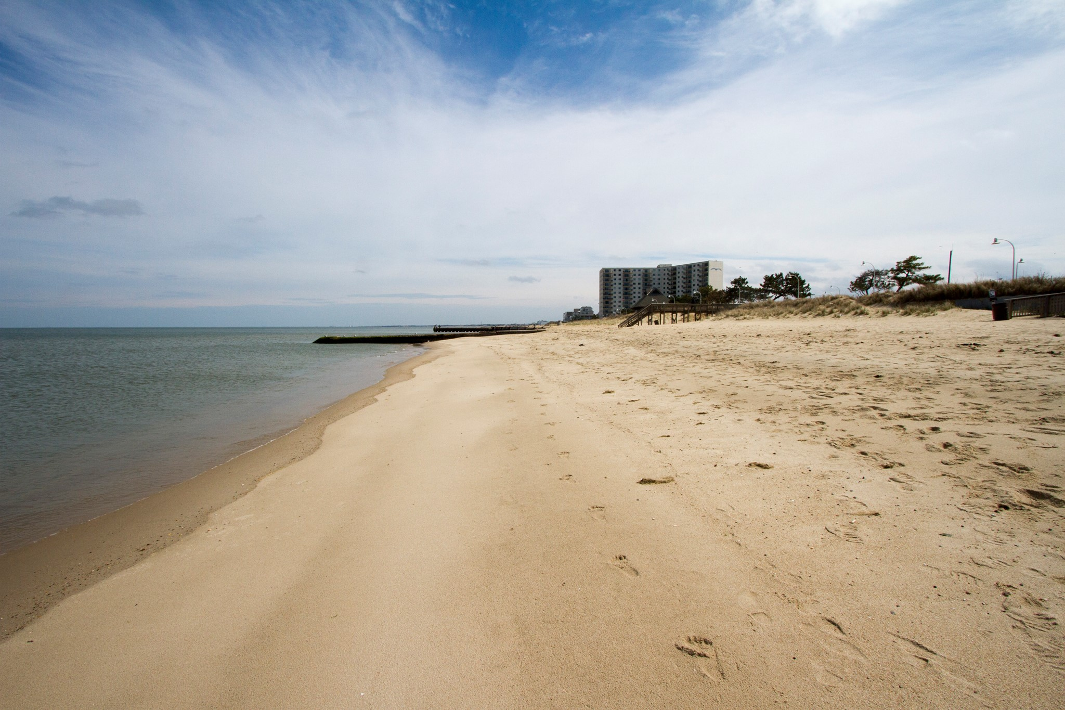
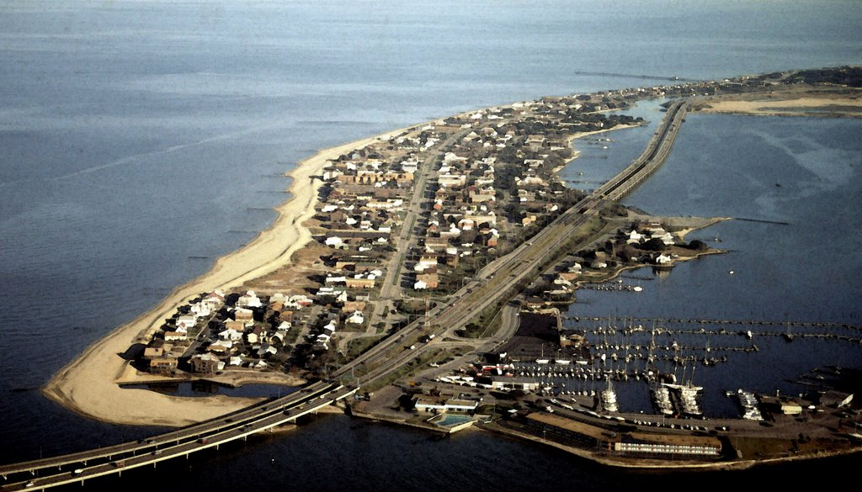
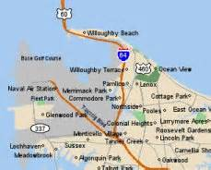
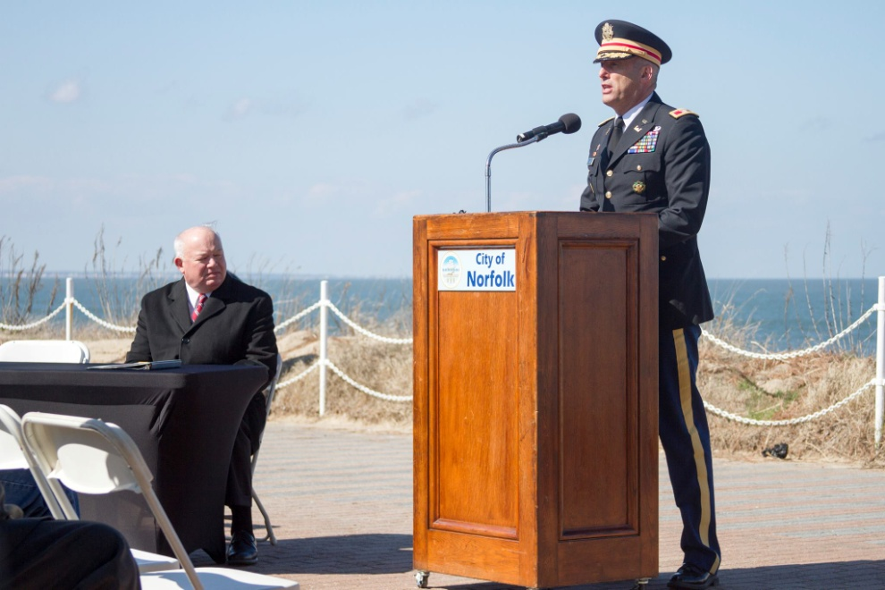
“The sea level rise fight starts right here, right now.”
April 10, 2015
Willoughby
Spit
Notes:
CAPT Ogle to brief first bullet – USCG and USACE Staff Talks. The reason for the briefing.
COL Backus brief 2nd bullet – Who is the Corps.
CAPT and COL to jointly brief common shared interests.

Slide 11
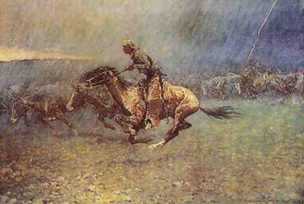
Our Future?
A Requirement for Leadership

Slide 12
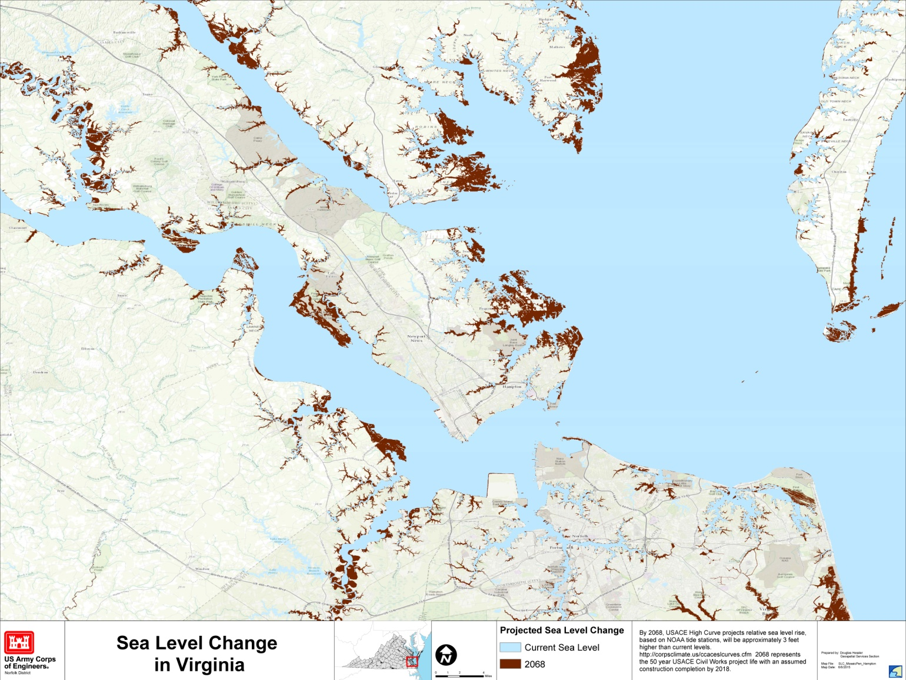
Our Future?
A Geophysical Approach

Slide 13
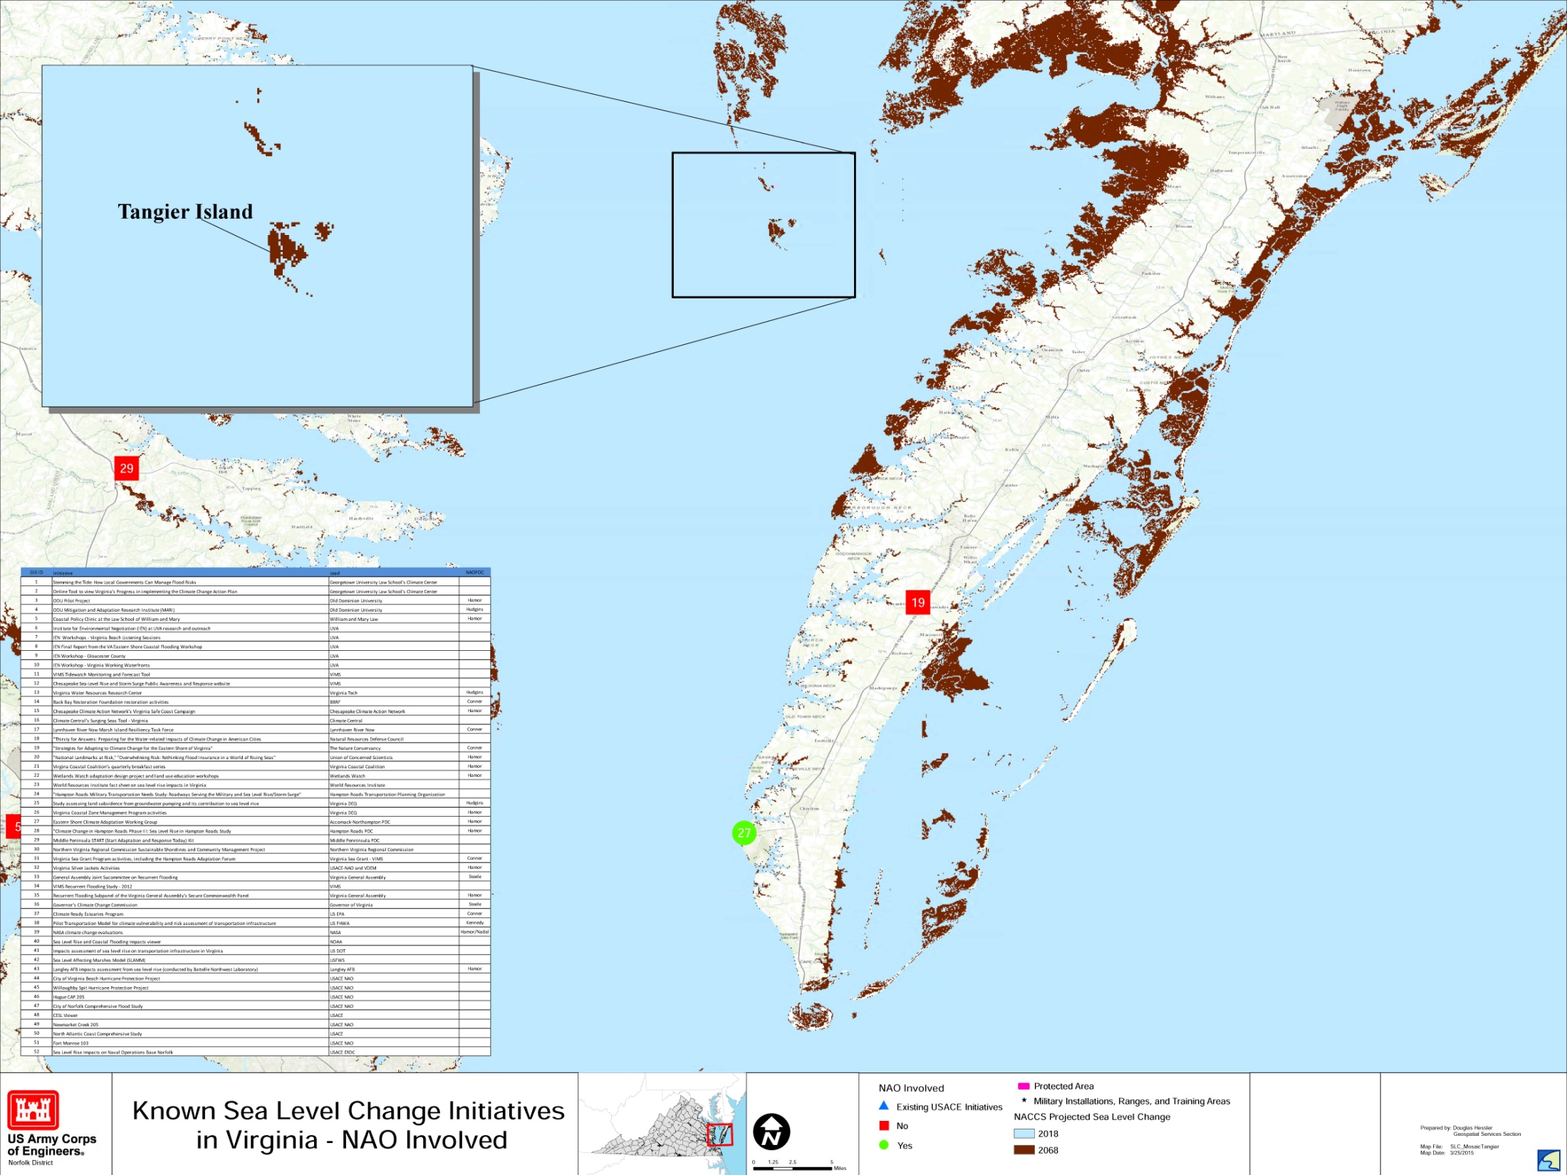

Our Future?
Identify Geophysical Regions
Prioritize Regions
Budget for Study Cost Share ($1.5M ea)
Budget for Projects (Studies and Construction)
Metrics and Milestones
A Strategic Campaign Plan

Slide 14
Our Future?
A Spirit of Partnership
You Matter!

Slide 15
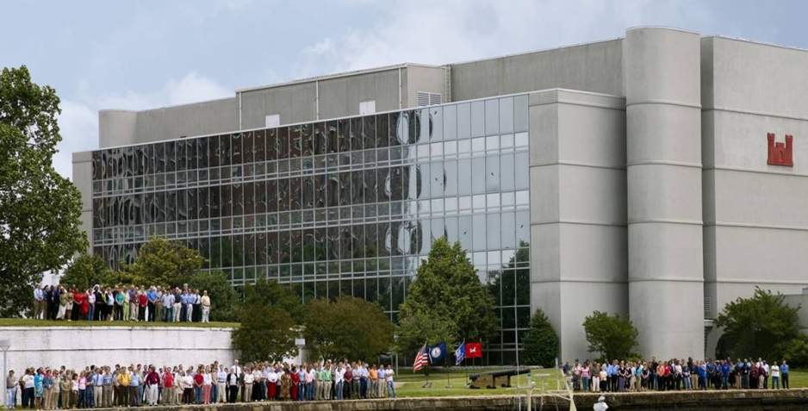
We Are Norfolk District
380 Dedicated Federal Employees
At Your Service – Ready for your Questions

