Slide 1
Eastern Shore VA Superstorm Sandy Recovery WCV Dredging: Segment Prioritization
Eastern Shore Community College
Workforce Development Center
Melfa, Virginia
August 16, 2013
“A Unified Voice for Navigation, Project Prioritization, and the Future Success of Waterborne Commerce on Virginia’s Eastern Shore”

Slide 2
Meeting Participants
Corps of Engineers, Norfolk District
US Coast Guard, 5th District and local stations
Congressional Representatives
Representatives from:
Accomack and Northampton Counties
Eastern Shore VA towns
Working Watermen’s Association
Harbor Committees
Virginia Marine Resource Commission
Harbormasters
Local industry and economic development interests

Slide 3
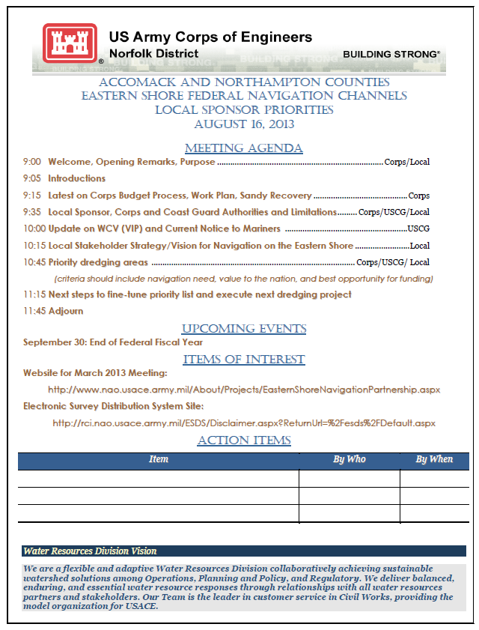
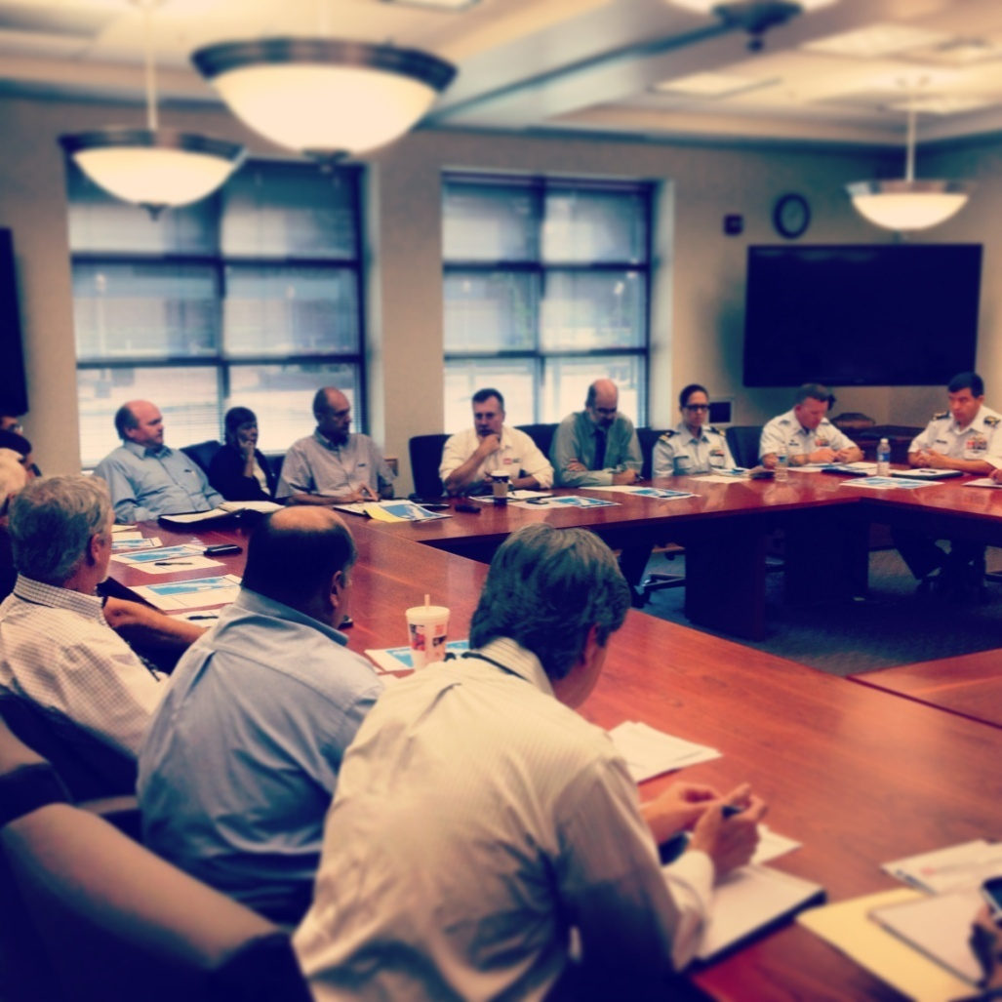
Meeting Agenda

Slide 4
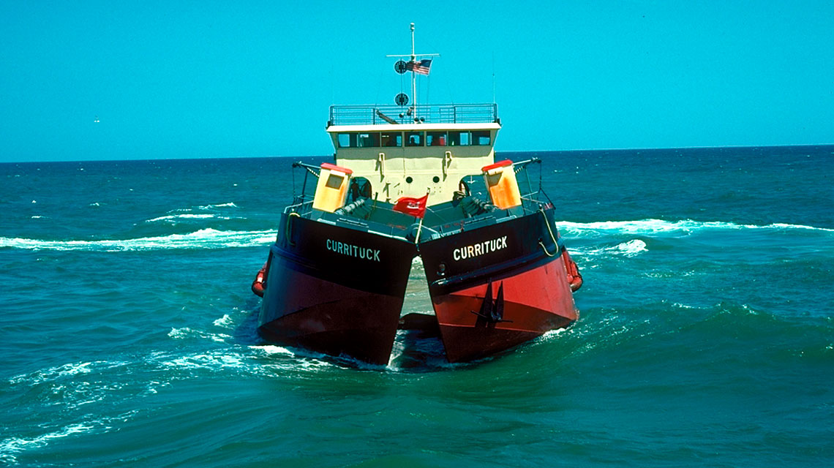
Waterway on the Coast of Virginia (WCV)
Currently minimally funded
through the President’s budget
process.
Multiple channels currently
impacted due to shoaling and
and decreased dredging in
recent years.
Regional collaboration and
consolidated approach is
required to re-energize
continuous dredging operations

Slide 5
Eastern Shore Federal Navigation Projects

Slide 6
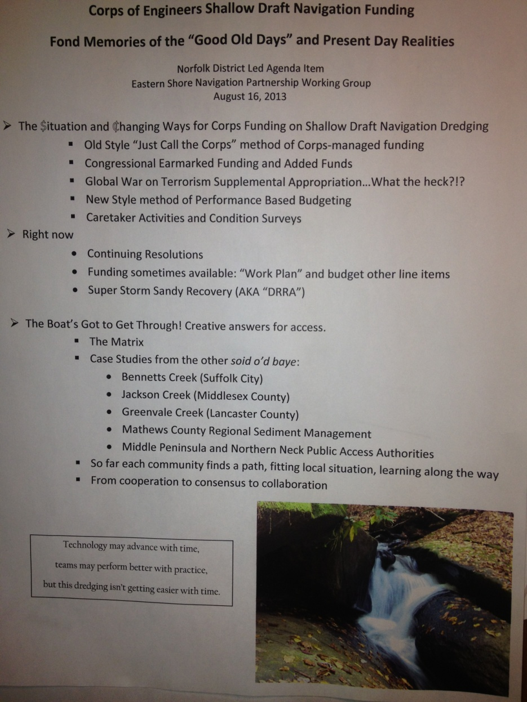
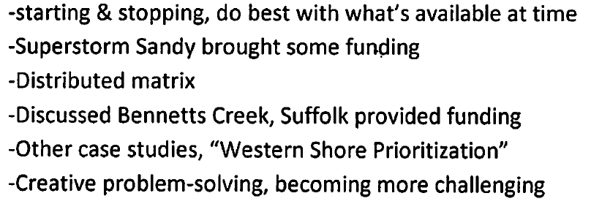
Current State of Corps Funding

Slide 7
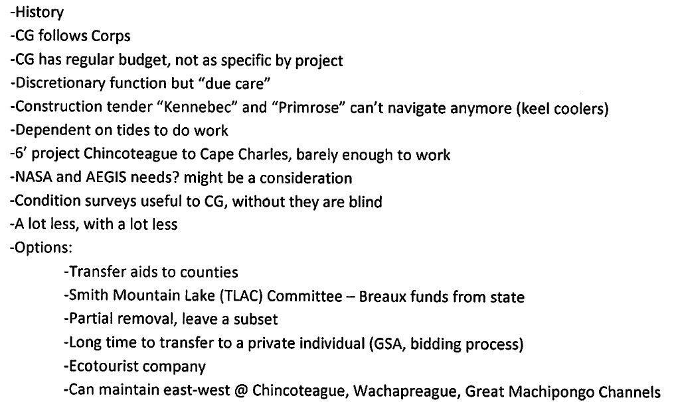
US Coast Guard – Eastern Shore Status

Slide 8
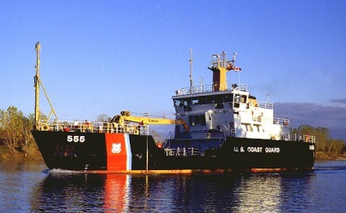
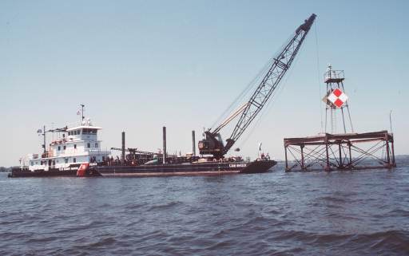
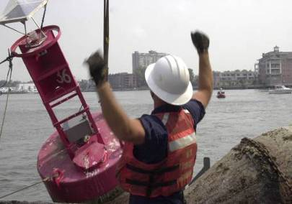
USCG Navigation Challenges
Removal of most Aids to Navigation on Eastern Shore

Slide 9
Additional Inputs for Participants to Consider for Criteria Weighting During Prioritization
US Coast Guard – 160’ long ATON tender has only 1 or 2 places where the vessel can turn around.
Working Watermen’s Association - Quinby area has about 60 aquaculture employees and about 30 watermen generating several million dollars in that area.
Harbormaster, Watermen’s Association, Town – reference Aids to Navigation are still needed, particularly at night
Corps – consider areas NOT needing dredging - if vessels are re-routed through/to other areas; there is an increase in transportation costs that should be accounted for.
Economic development concerns and town representatives - VIMS economists may be able to help capture economic and environmental benefits of the Eastern Shore waterways, perhaps study should include both bayside and seaside, perhaps form an Eastern Shore waterways board and comprehensive strategic plan

Slide 10
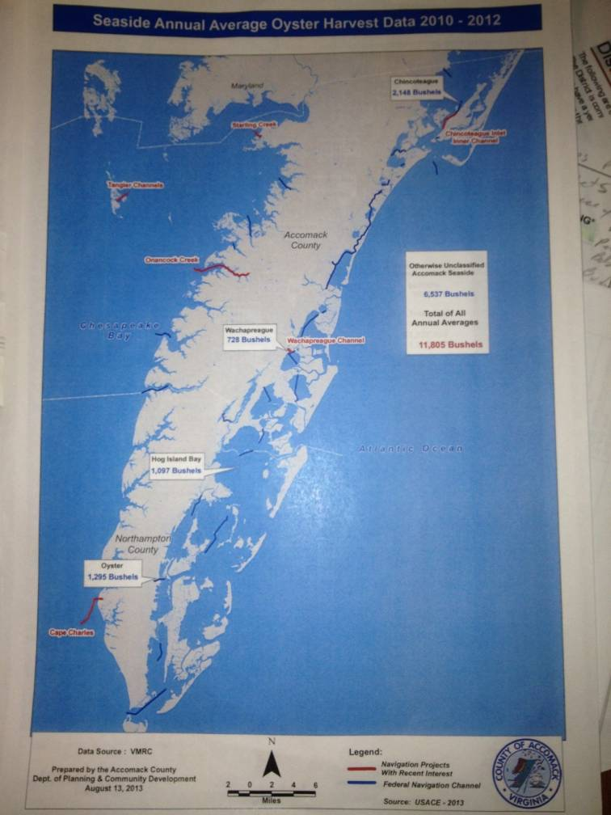
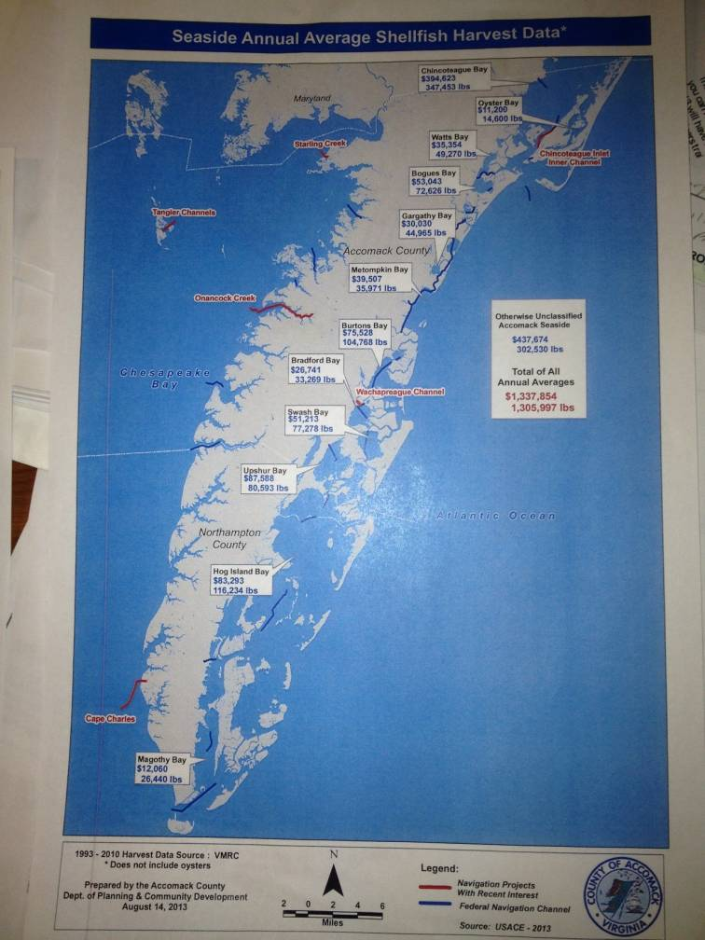
Local Sponsor Furnished Information
Annual Average
Oyster Harvest Data
Annual Average
Shellfish Harvest Data

Slide 11
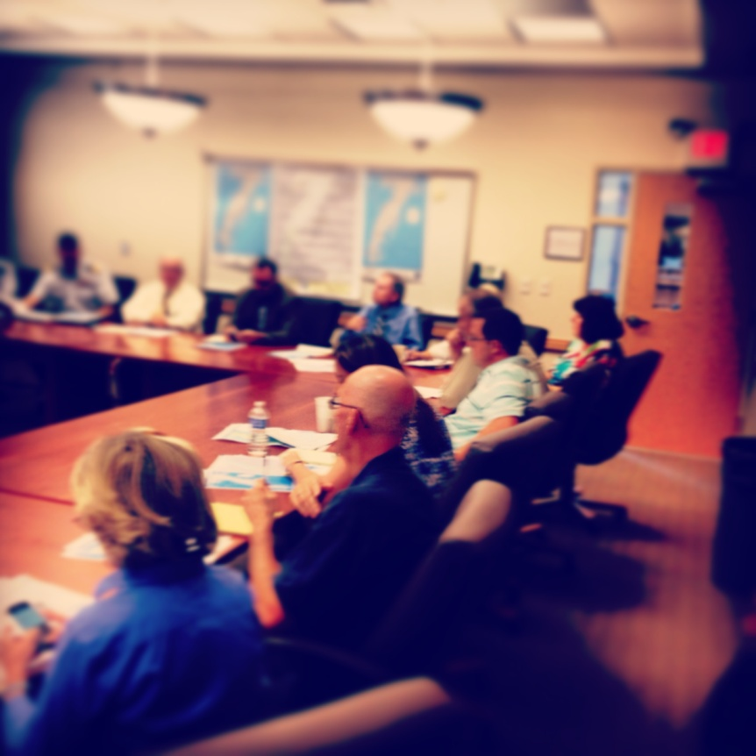
Project Prioritization Criteria 1
Sensitive to US Coast Guard navigation aid maintenance capability
Dredged material placement site capacity
Environmental permits
Resource time of year restrictions
Project commercial usage

Slide 12
Project Prioritization Criteria 2
Any identified dredging area must be a segment within the authorized Waterway on the Coast of Virginia (Virginia Inside Passage) project.
Seaside tributaries and Bayside Federal navigation channels are excluded and not eligible for consideration under the current criteria.

Slide 13
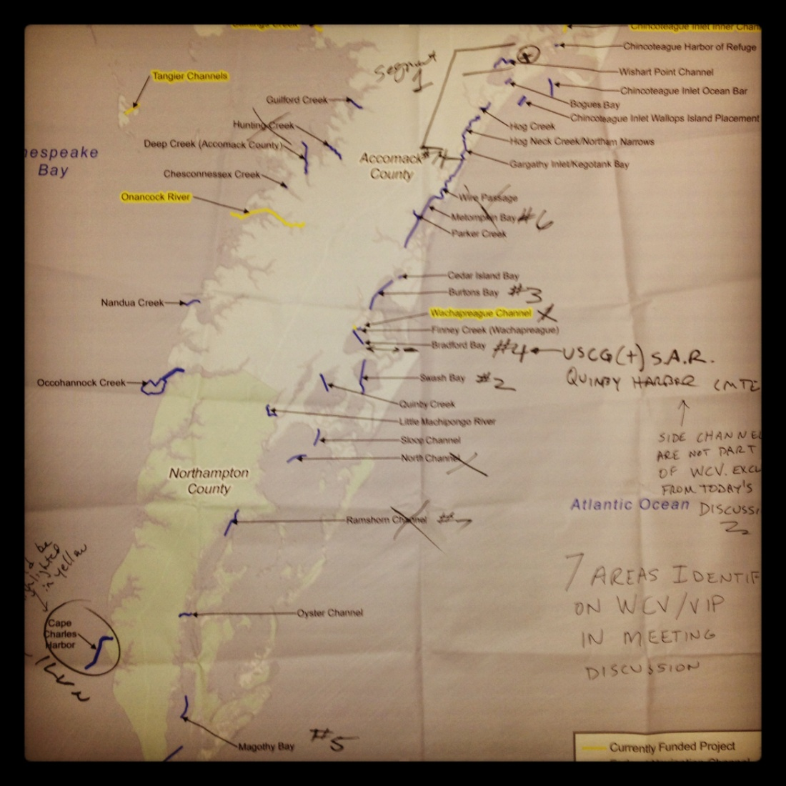
In-Meeting Prioritization Process
Excerpt of meeting map with markups
Identified key areas on the WCV that need dredging.
Each area considered with respect to criteria on slides 3 and 4.
Prioritization process: Considered need and usage of each shoaled area.
Each represented group queried to verify rationale.
Group consensus used to identify one shoal to begin efforts to dredge in near future.
Need survey and map of the full length of WCV.

Slide 14
Key Meeting Decisions
Identified priority areas on the WCV that need dredging.
Each area considered with respect to criteria on slides 3 and 4.
Prioritization process: Considered need and usage of each shoaled area.
Each represented group queried to verify rationale.
Group consensus used to identify one shoal to begin efforts to dredge in near future.
Need survey and map of the full length of WCV/VIP.

Slide 15
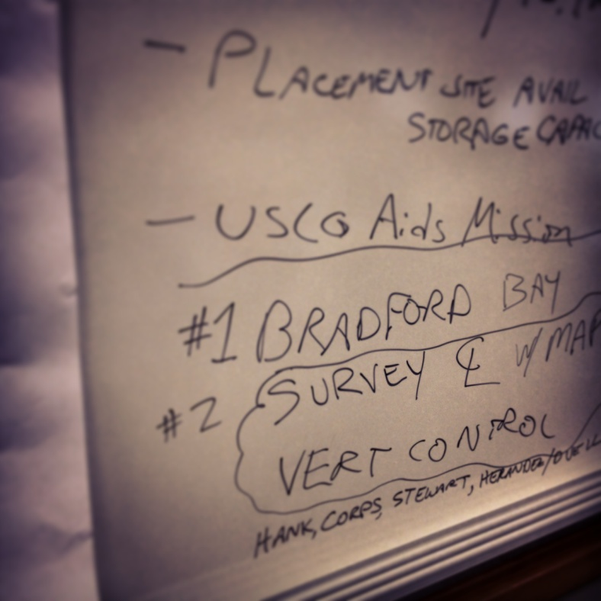
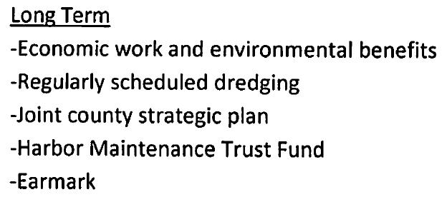
Meeting Outcomes

Slide 16
Meeting Credits
Eastern Shore Community College Workforce Development Center – providing meeting facility and resources
Accomack County Staff – Meeting Notes
Corps of Engineers, US Coast Guard, Accomack County – Agenda development
For more information regarding this meeting, contact
US Army Corps of Engineers,
Norfolk District
757-201-7861

Slide 17
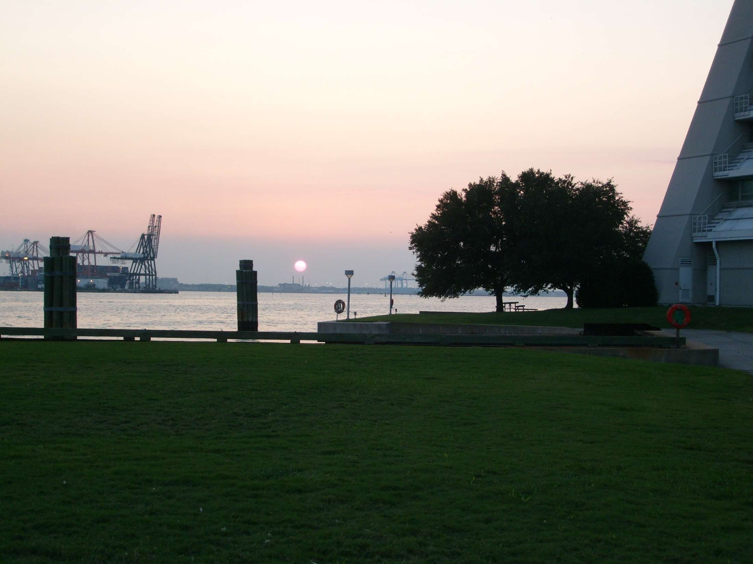
Questions/Comments?
Contact Information: Norfolk District, USACE
Operations Branch

